Slide 1
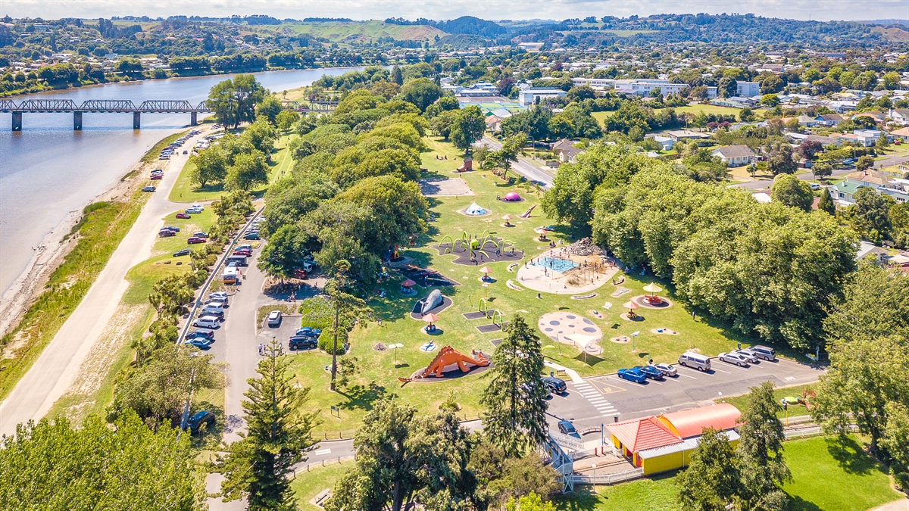
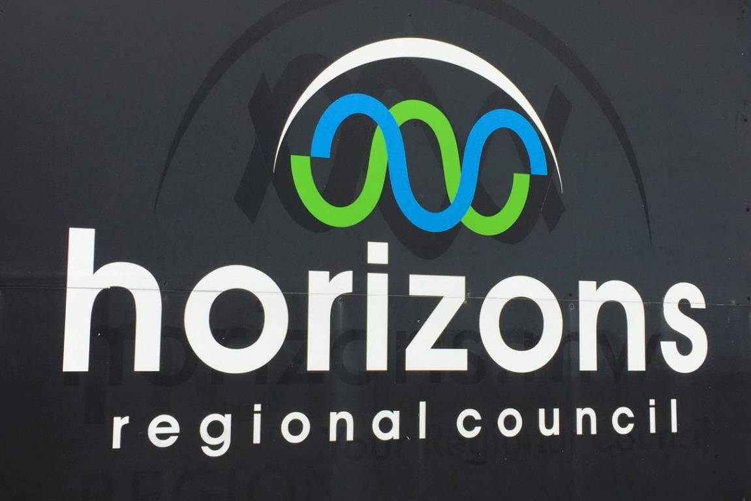
Anzac Parade: flood resilience strategy update Bruce Glavovic, Martin Garcia CARTAGENA, Kathryn mcdowell
20th April, 2022

Slide 2
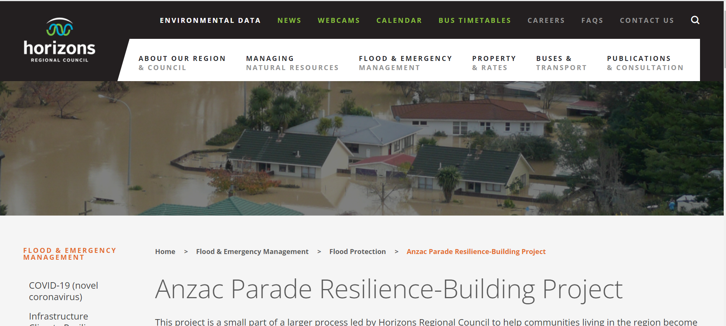
Meeting Purpose & agenda
Karakia
Explain Project: Anzac Parade Flood Resilience Strategy
Update on recent information (cost estimates for raising houses and legal, geo-technical, and climate change impacts on flood risk)
Discuss likely scenarios
Next steps & closure
https://www.horizons.govt.nz/anzac-parade FAQs, Fact Sheets

Slide 3
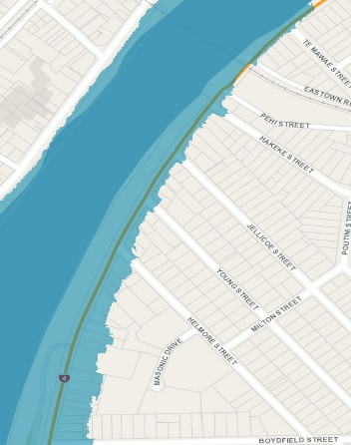
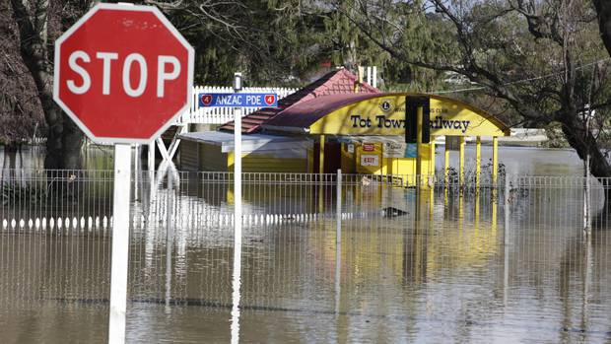
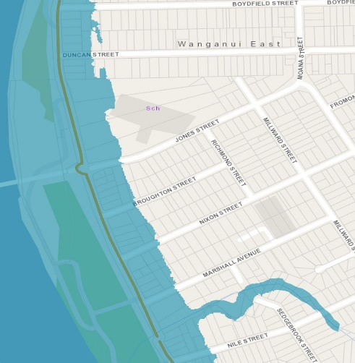
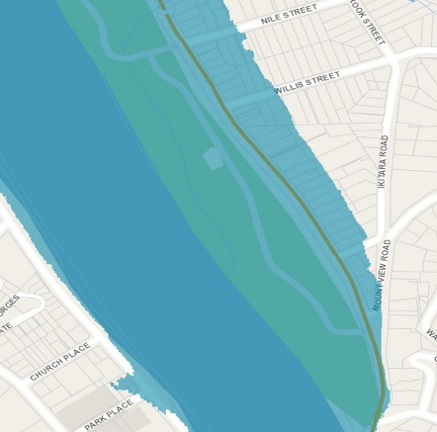
PROJECT AIMS
Role of Massey researchers:
Bridge to link AP residents, home-owners, hapū, iwi, awa, WDC, Horizons, stakeholders & public
Facilitate community-based strategy
Create a co-designed strategy to reduce flood risk & increase community resilience along Anzac Parade.
Assess feasibility of range of community-wide and property-specific interventions.
Make recommendations based on implications of alternative interventions for flood risk reduction, resilience building, & resident & community well-being.
Horizons Regional Council will decide on way forward.

Slide 4
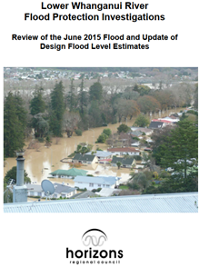
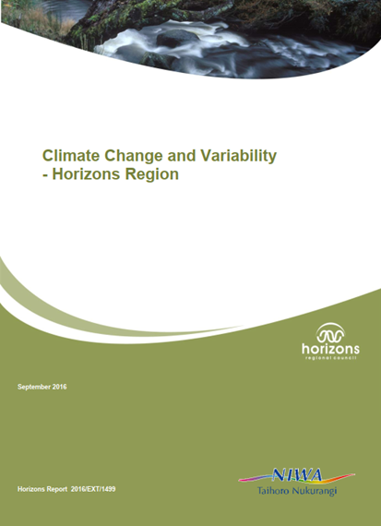
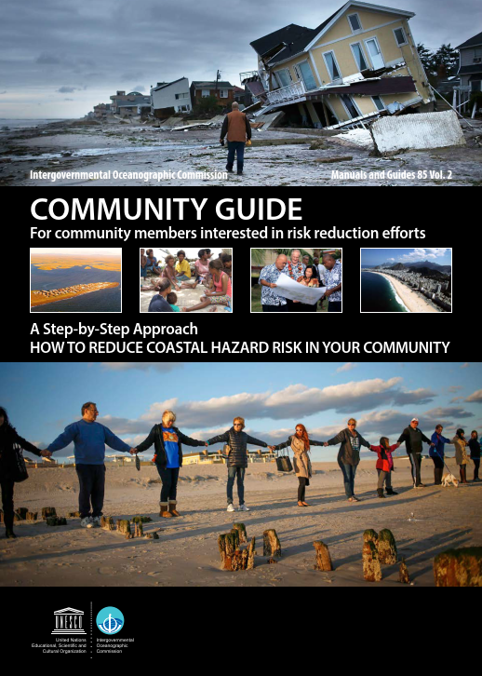
WHAT IS a flood resilience strategy?
Agreed way to reduce flood risk & build resilience (1-100y)
Based on:
Assessment of risk now & future – given community concerns & climate change
Evaluation of pros & cons of different options to reduce flood risk
Plan with best combinations of options to implement over time
Roles & responsibilities for implementing plan
Agreed process to monitor, review & revise strategy in future

Slide 5
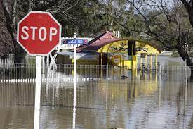
Why a flood resilience strategy?
Whanganui flood, 2015
Increasing flood risk is reality around world
Climate change makes flooding worse
NIWA (2016): West of region +10-20% > winter rainfall (2040-90); sea-level rise
Whanganui awa floods
June 2015 flood = 4775-5150 cubic metres per second; 1:130-150 yr
Floods >4000 cumecs: Mar 1990, Feb 1940, Aug 1939, May 1904, Feb 1891, Sep 1858, 1864 & 1875
Not a sedimentation problem – 2015 capacity of channel > 1995 (Horizons, 2016)
Need to address flood risk & build community resilience
Taken seriously – Strategy formulation supported by Horizons, WDC, mana whenua, awa
Your views about way forward matter & will inform the strategy
Horizons Regional Council commissioned Massey researchers to facilitate strategy
Horizons Regional Council will consider recommendations & decide on way forward
Realistic expectations – Complex issue with many different parties involved in implementation

Slide 6
What Does 1 in 100 year FLOOD mean?
1:100 year flood ≠ flood only happens every 100 years
It is statistical measure
1:100 year flood = likelihood flood level reached once in 100 years
Or 1% chance of flood level being reach in any given year

Slide 7
Summary: previous ANZAC pARADE hui
In summary:
Interventions in Matarawa Stream & awa not enough to reduce flood risk.
Stopbank upgrade is challenging: technically, regulatory & affordability.
Raising some houses may be feasible, but more information needed on geotechnical, planning, structural & financial implications.
Buy-out &/or relocating some houses may be possible, but need more detailed assessment about who would pay for buy-out / relocation; unlikely in short term.
Nuisance flooding measures may be effective for small-scale events but not major floods; guidance may help.
Have evacuation plan, enrol in early warning system, be ready!

Slide 8
Options: Matarawa Stream
We confirmed that the Matarawa Stream does not contribute significantly to major Whanganui awa flood events in this area, but CC might change this.
However:
Regular maintenance & clearing of Matarawa Stream (Gerse St. culvert) could help reduce nuisance flooding to nearby properties & improve water flow.
Status quo, no CC, 0.5 AEP (1:200yr)
Status quo, RCP 8.5, 0.5 AEP (1:200yr)

Slide 9
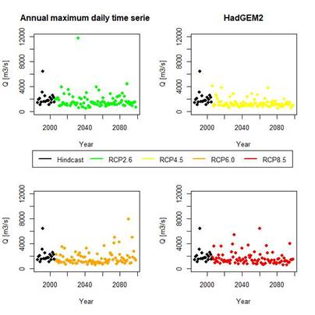
Context: Whanganui Awa and climate change
Annual maximum daily average flow time series over the period 1986-2098 for the HAdGEM2 GCM for 4 RCP scenarios
Climate change projections developed by NIWA indicate that:
Existing flood frequency statistics for large events are based on a long gauging record & consider historic peaks. At present this provides us with a robust basis to quantify the impacts of a large event in the Anzac Parade area.
There is inherent uncertainty in estimating the impacts of climate change.
There could be little change in the less frequent storms (50,100, 200yr events).
There could be an increase in the magnitude of more frequent events (i.e., 10, 20, 30 yr events).

Slide 10
Options: Stopbanks
Horizons plus Tonkin & Taylor assessment indicates:
Serious technical challenges (e.g., seepage)
High costs (e.g., ~$6-7 mill for 1:50 year protection; >$10 mill for 1:100 year protection) & affordability; $27-33 mill for 1:200 year protection)
Regulatory challenge given awa legal status
2017 consultation by Horizons: Whanganui ratepayers reluctant to pay cost of increased protection at Anzac Parade
Protection through targeted rates but no agreement by Anzac Parade residents
Stopbank upgrades not feasible because of technical & regulatory challenges & affordability
Higher stop banks /at same level all along
Flood gates/barrier at Park/Boat ramp entrances
Sheet pile in stop banks

Slide 11
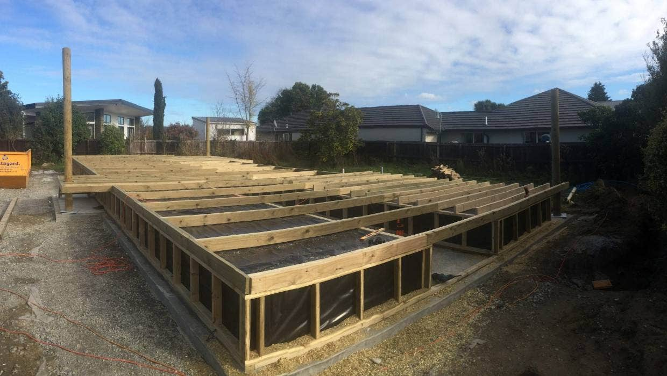
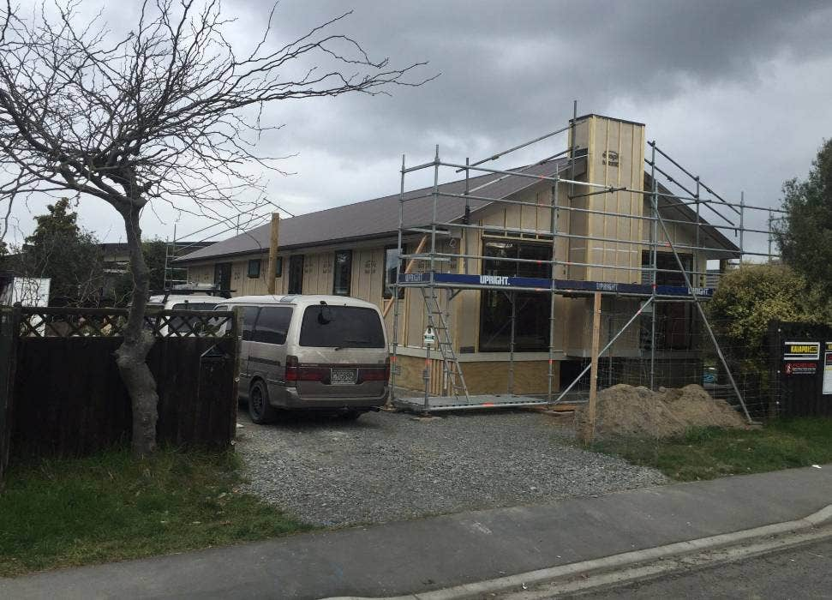
Options: Raising houses
Planning implications:
Alterations to buildings are possible as long as they comply with the following:
Suitable finished floor or ground level after allowing for freeboard above the 200 year flood level
Safe access/egress
Resilient building methods that provide resilience for up to a 1 in 200 year flood event
The avoidance of significant diversion of flood flows as a result of the development
Lift houses
Kaiapoi, Waimakariri, Canterbury
Floating houses … cost … float away?

Slide 12
Options: Raising houses
Cost implications:
Buildings in the most at risk areas are raisable to 1 M, but costly (NZD 300,000 – NZD 534,000).
Variables affecting the price: <100m2, heavy roof, brick veneer, chimney, 2 storeys.
Base cost includes: Disconnection, jacking and chocking, demolition of existing substructure, new foundations, disposal of demolition materials, lowering and reconnection to new foundations, extending services (power, gas, water, drainage, data), and access steps/landing.
Excludes: Outbuilding works, groundworks, Geotech surveys (where required), asbestos removal, accessible ramps, building consents, inflation, replacement of heavy roofs and/or chimneys.
Lift houses
Indication of scope to raise houses
1:100yr (<1m): 40 H; $12Mill<
Many additional costs & regulatory challenges

Slide 13
Options: Buy-out &/or relocate houses
There are planning tools to enable a buy-out &/or relocation program.
WDC is currently looking into a few potential Council owned sites for future development.
In the future, a plan change may be required to enable convert vacated lots into open space.
However, greenfield development is almost entirely in the hands of private sector.
Social and cultural challenges.
None of these issues will be solved in the short term.
Don’t live on a floodplain
Relocate houses
Indication of scope of buy-out
1:50yr (>1m): 34 H; RV $9.5mill
1:100yr (>1m): 40 H; RV $10.8mill
1:200yr (>1m): 50 H; RV $15.6mill
Many additional costs & regulatory challenges

Slide 14
Options: Buy-out &/or relocate houses
There are two legal mechanisms to enable a buy-out &/or relocation program.
Covenant in gross in favor of Horizons (voluntary).
Public works Act 1981 (compulsory).
If rented properties were bought, the buyer (Horizons) would have to see tenancy agreements through.
The question of who pays, and whether central government would contribute is not resolved.
Don’t live on a floodplain
Relocate houses
Indication of scope of buy-out
1:50yr (>1m): 34 H; MV $17.7mill
1:100yr (>1m): 40 H; MV $21mill
1:200yr (>1m): 50 H; MV $28.1mill
Many additional costs & regulatory challenges

Slide 15
Options: Reduce nuisance flooding
Whanganui District Council has a Stormwater upgrade program in place.
Whanganui East is included as one of the priority areas to invest in system improvements to reduce nuisance flooding.
However, this is a long term plan (30 Year Infrastructure Strategy), and this will not address the risk of major floods, only nuisance flooding.
Sandbags
Planting
Inflatable banks
Clear logs
Keep drains clear
Monkey cheek method in Thailand
Stormwater soakpits – waterlogging ground

Slide 16
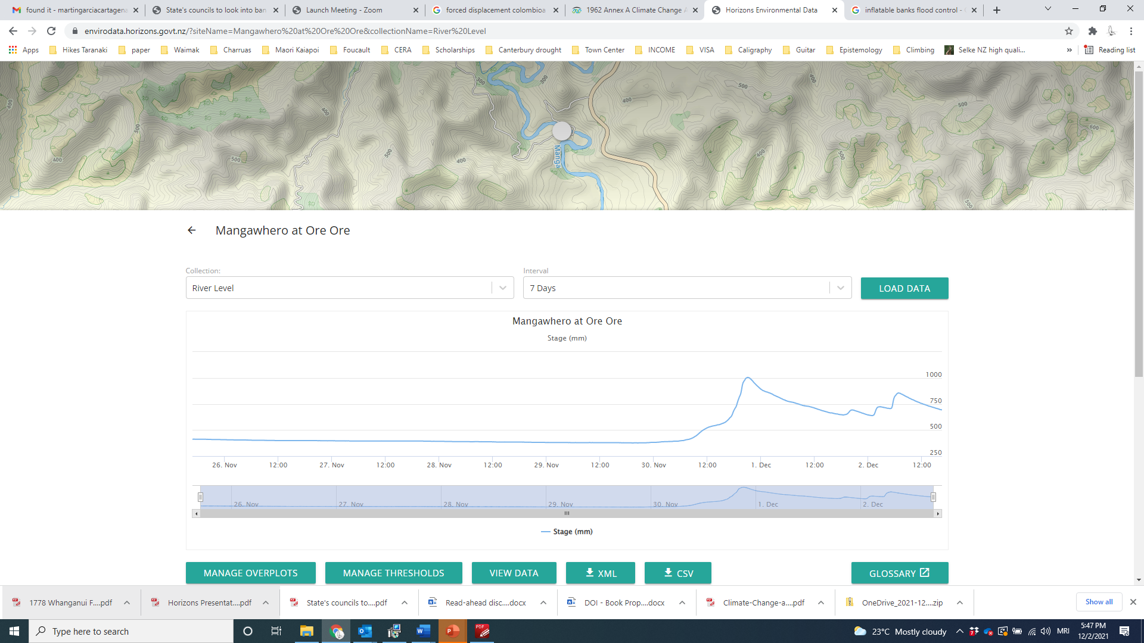
Options: Early warnings & evacuation
Horizons and Whanganui District Council have taken note of the difficulties experienced by some residents to register and interpret the early warning system.
They are considering ways to improve these processes.
https://envirodata.horizons.govt.nz/
TWO
Have a 'go bag' ready with essential medication, masks, special dietary items, copies of important documentation, animal food etc. Visit Civil Defence website www.civildefence.govt.nz
ONE
Register on Horizons Flood Alert page at www.horizons.govt.nz/river-alert-system
THREE
Practise with your pets so they are comfortable getting in & out of carry cage if you need to move them in a hurry.

Slide 17
Flood risk reduction suggestions
In summary:
Very limited options to address flood risk in short- to mid-term.
Improvements on early warning system and evacuation procedures.
Keeping Matarawa Stream clear.
Stopbank upgrade infeasible due to technical, regulatory, financial, and CC reasons.
Long term options are reduced to raising houses or buy-out/relocation program, but associated high uncertainty.
Raising houses is feasable but costly and not cost-effective, especially in the context of CC.
Buyout/relocation program is more cost-effective, but highly uncertain given the lack of guidance from central government re government contribution to cost sharing.

Slide 18
NEXT STEPS
Public meeting to engage the wider Whanganui public (5 May’22)
Draft AP Resilience Strategy available for resident, mana whenua, awa, stakeholder & public review & feedback (May-June’22)
Final AP Resilience Strategy publicly reviewed then submitted to authorities for decision (end June’22)

