Slide 1
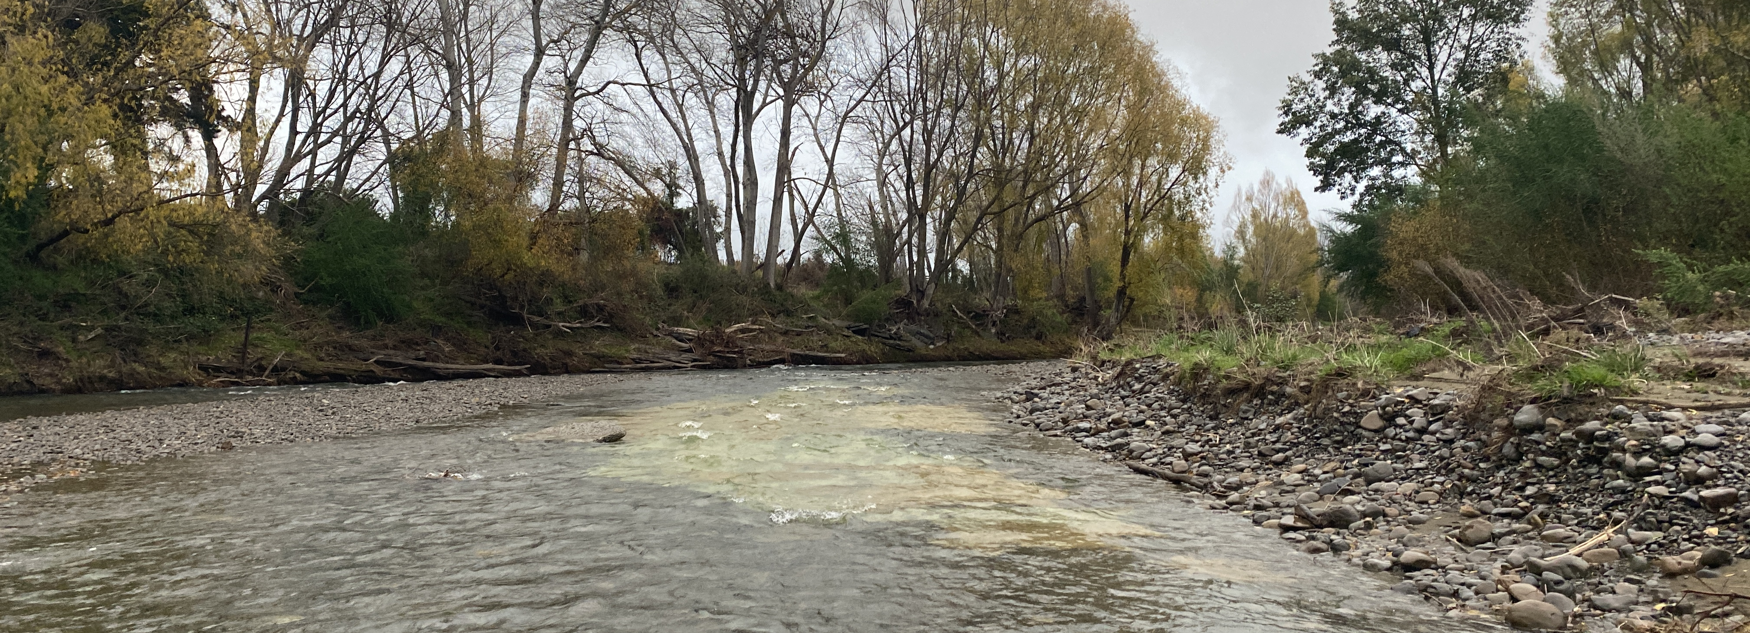
Pohangina and Ōroua Scheme Sub Committee Meeting
May 22, 2026, Te Ao Nui building, Horizons Regional Council

Slide 2
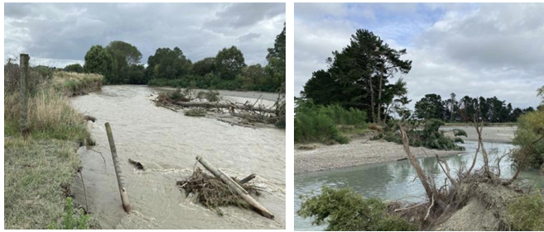
Presentation Format
Recap
The August 2025 scheme meeting allocated the full maintenance and repair budget all to repairs (11 jobs). Maintenance works were completed limiting budget for the repairs.
Prior to February event, 60% through the year, the scheme had spent 63% of the maintenance and repair budget.
The mid-February event caused significant damage.
A scheme meeting was held a few days later. 19 Feb. 2026
The scheme requested damage to be reported back in March.
The 16 March 2026 scheme meeting:
  Discussed planned work & status of repairs.
  Decided to seek further funding from Council including a $1M loan and to progress work with available funds in the meanwhile.
  Appointed a sub-committee.
An item was presented to Council on 21 April 2026. Funding reallocation and additional funding was approved.
Email comms were sent to the sub-committee before and after the April item. Two further events occurred in April 2026.
Works have progressed in the meanwhile.
Today is the first sub-committee meeting (22 May 2026).
Scheme Budget 25-26
Budget Update and April Council Approvals
Cost of Works in Progress or Planning
26-27 Financial Year budgets
Maintenance and repair options
Prioritisation discussion

Slide 3
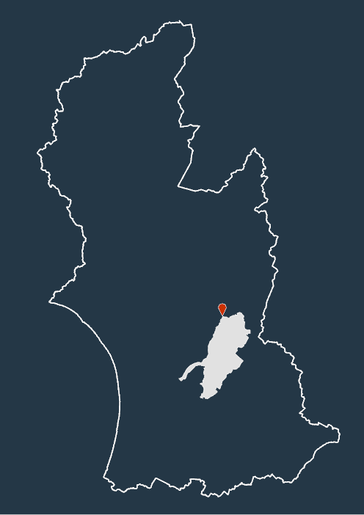
 |  | 2025-26 ($) | 2026-27 ($) | Movement
Expenditure Schemes
Maintenance |  | 279,980 | 279,998 | 0.0%
Repairs |  | 133,284 | 133,284 | 0.0%
Internal Cost (Staff, vehicle, etc) |  | 120,105 | 135,695 | 13.0%
Insurance |  | 1,517 | 1,393 | -8.1%
Reserve Contributions |  | 60,000 | 60,000 | 0.0%
External Cost (rates etc) |  | - | $- | 0.0%
Loan Funding |  | 46,913 | 46,287 | -1.3%
Depreciation Funded |  | - | $-
Sub total - Operational expenditure |  | 641,799 | 656,658 | 2.3%
Capex |  | - | $- | 0.0%
Total Expenditure Schemes |  | 641,799 | 656,658 | 2.3%
Funding
Scheme Rates |  | 448,014 | 459,900 | 2.7%
General Rates |  | 112,003 | 114,975 | 2.7%
Total Rates |  | 560,017 | 574,876 | 2.7%
Capital Grant Funding |  | - | - | 0.0%
Loan Drawdowns |  | - | - | 0.0%
Reserve Drawdowns (Targeted + General) |  | - | - | 0.0%
Other (Leases and Rental) |  | 81,782 | 81,782 | 0.0%
Total Revenue |  | 641,799 | 656,658 | 2.3%
Reserves |  | Closing Balance 30-06-25 | Closing Balance 30-06-26 | Closing Balance 30-06-27
Estimated EM Reserve Target |  |  | 17% | $ 1,140,000
Estimated EM Reserve Balance (Targeted Only) |  | 91,647 | 143,359 | $ 196,806
Difference |  |  |  | -$ 943,194
Renewal Reserve Balance |  | - 33,821 | - 35,191 | - $ 36,528
Loans | Closing Balance 30-06-25 | Closing Balance 30-06-26 | Closing Balance 30-06-27 | Remaining Loan Period 30-06-27
Loan Balances | 433,967 | 405,497 | 375,430 | 11
Scheme Budget 2025-26
Pohangina - Ōroua
As at Feb. 2026
Rates proposed 2.7%
Main driver is staff costs
Reserves were at 11% of target and rebalancing was required.
Of note
Scheme has landowner contributions for some works.
Scheme has demand that outstrips funding available.
May 2026
Subsequent Council decisions in April to discuss today.

Slide 4

Budget spend and new approvals (Summary of April Council Item pages 111 to 116)
Budget status prior to the April paper | Maintenance Budget |  |  |  | Repair Budget |  |  |  | Total
 | # of jobs | ($) | % of budget | budget remaining | # of jobs | ($) | % of budget | budget remaining | # of jobs | ($) | % of budget | budget remaining
Budget at start of year |  | 279,980 |  |  |  | 133,284 |  |  |  | 413,264
Completed by Feb 2025 | 15 | 157,730 | 56% | 122,250 | 11 | 103,302 | 78% | 29,982 | 26 | 261,032 | 63% | 152,232
17 March to Early April | 2 | 19,255 | 7% |  | 1 | 45,000 | 34% |  | 3 | 64,255 | 16%
Total to early April | 17 | 176,985 | 63% | 102,995 | 12 | 148,302 | 111% | -15,018 | 29 | 325,287 | 79% | 87,977
The two maintenance jobs in March April were in the lower Ōroua and Tokeawa in the Pohangina. The repair job in April was in the Ōroua River
Proposed work plan: budget considerations
Remaining budget (at April 2026)
Remaing maintenance budget | 102,995
Sub total | 102,995
Additional budget
Reserves drawdown | 72,283
Budget in 2025-26 for reserves | 60,000
Loan drawdown | 200,000
Sub-total | 332,283
Estimated additonal costs
Additional staff time | -30,000
Consenting costs | -45,000
Overspend on repairs | -15,018
Sub-total | -90,018
Net budget to spend | 345,260
Summary:
Prior to February event scheme had spent 63% of the maintenance and repair budget (60% through the year). See Table above.
The April item sought Council approval for the scheme committee decisions to:
  Reallocate funds intended to go to reserves.
  To drawdown all of the reserves.
  To drawdown a scheme loan of $1 million (M) over several years.
The Council item sought a loan of $200k. In part due to the item being focussed on delivery to 30 June 2026. Also, as there is not staff capacity to deliver $1M of additional work.
Council approved the funding requests (see Table to the left). After considering costs an additional $345k is available more than doubling the available budget for works in the 2025-26 year.
Works have continued. Staff capacity has been increased staff from Tararua.
Next few slides show the planned work and seek feedback on priorities.

Slide 5
Works to progress over April/May and planned to 30 June 2026
Decisions are required on what works to advance on:
This year (to be completed or planned in the period to 30 June 2026) and over the 1 July 2026 to 30 June 2027 period.
Items for consideration include:
The 11 repair jobs prioritised in August 2025. Four of these a now complete.
The 38 repair jobs identified post the February event and shown in the March scheme meeting powerpoint.
Any new repair (currently unknown) jobs that are identified over the period from now to 30 June 2026.
Other costs for the scheme, consenting, staff, etc.
Staff are currently planning to complete 6 jobs over the period to 30 June 2026: 3 maintenance jobs. 3 repair jobs
Budget implications
Based on this, the budget is not expected to draw down all of the reserves or any of the approved loan.
This would provide approx. $217k to transfer through to next years work programme.
This would not impact the projected rates increase for next year.
Reallocating the budgeted amount for reserve contributions ($60k) could add a further $60k for works.
Options for the additional funding are presented as a starting point for consideration below.

Slide 6
Current work in progress and planning to 30 June 2026
Maintenance Jobs |  | 2025-26 ($) | 2026-27 ($)
Ōroua Maintenance | Currently underway | 60,000
Coulters Line | Programmed | 40,000
Upper Ōroua | In discussion | 21,000
Tokeawa Poplars | Proposed |  | 21,000
Raumai | Proposed |  | 60,000
 | Sub-total | 121,000 | 81,000
Consent cost | Sub-total | 20,000 | Could be $100k or more*
Repair Jobs
Silks | Completed awaiting invoice | 45,000
Hocken | Programmed | 75,000
Davis | Planning | 35,000
Edwards | Planning |  | 85,000
Wards | Planning |  | 60,000
 | Sub-total | 155,000 | 145,000
 | Total | 296,000 | 226,000
April to June 2025-26 forecast spend includes:
3 maintenance jobs totalling 121K
A further estimated 10k on consenting
3 repair jobs totalling 155k
In total about $286K spend
Staff costs will be additional (estimate approx. $30k)
Full year budget projections are on the next slide
*consent costs remain unknown, a notified hearing could cost more than $100k.

Slide 7
Budget projections 2025-2026
 | Actual Expenditure ($) 15-5-26 (Provisional) | Budget 2025-26 ($) | Revised Budget. Inc. April Approvals($)* | Planned Expenditure May-June ($) | EOY Forecast ($)
Revenue
Targeted Rates | 337,345 | 448,014 | 448,014 |  | 448,014
General Rates | 93,336 | 112,003 | 112,003 |  | 112,003
Misc Revenue | 61,981 | 81,782 | 143,763* |  | 156,204
Loans |  |  | 200,000 |  | 200,000
Reserve Interest |  | 15,833 | 15,833 |  | 15,833
Reserve Drawdown |  |  | 132,283 |  | 132,283
Total | 492,662 | 657,632 | 1,051,896 |  | 1,064,337
Expenditure
Maintenance | 162,000 | 279,980 | 279,980* | 121,000 | 283,000
Repairs | 105,340 | 133,284 | 450,556* | 155,000 | 260,340
Capex | 13,417 | 0 | 13,417 |  | 13,417
Management | 207,568 | 155,898 | 155,898 | 33,950 | 261,518
Loan Funding Principal |  | 28,469 | 28,469 |  | 28,469
Reserve Contribution |  | 60,000 | 0
Total | 488,325 | 657,631 | 928,320 | 309,950 | 826,744
 |  |  |  |  | 217,593 Not spent
Management
Consent Cost | 43,730 | 0 | 0 | 20,000 | 63,730
Staff | 107,048 | 90,352 | 90,352 | 33,950 | 140,998
Insurance | 871 | 1,517 | 1,517 |  | 871
Other | 55,919 | 64,029 | 64,029 |  | 55,919
Total | 207,568 | 155,898 | 155,898 | 33,950 | 261,518
Forecasting 2025-26 budget spend to be $827K:
$170k more than original budget (25%)
$101,576 less than the revised budget
Considering planned works and proposed spend it is forecast that $217k of approved budget will not be used in 2025-26.
On this basis the loan will not need to be drawn and additional $217k is approved for next year.
*Revised budget may not be reflected accurately year due to the 60:40 split to fund repairs. To calculate this need to know the balance between maintenance and repairs

Slide 8
 | Budget 2026-27** ($) | Revised Budget Maintenance Program 1 (S) | Revised Budget Maintenance Option 2 ($)
Revenue
Targeted Rates | 462,335 | 462,335 | 462,335
General Rates | 115,584 | 115,584 | 115,584
Misc Revenue | 81,782 | 162,745 | 464,116
Loans |  | 200,000 | 200,000
Reserve Interest | 15,833 | 15,833* | 15,833
Reserve Drawdown |  | 17,593 | 17,593
Total | 675,534 | 974,089 | 1,275,460
Total Scheme Expenditure
Maintenance | 280,050 | 500,648 | 299,734
Repairs | 133,284 | 271,241 | 773,526
Capex
Management | 172,133 | 172,133 | 172,133
Loan Funding Principl | 30,067 | 30,067 | 30,067
Reserve Contribution | 60,000 | Reallocated | Reallocated
Total | 675,534 | 974,089 | 1,275,460
 |  | 45% more | 90% more
Management Breakdown
Consent Cost | 0 | ? | ?
Staff | 107,360 | 107,360 | 107,360
Insurance | 1,393 | 1,393 | 1,393
Other | 63,380 | 63,380 | 63,380
Total | 172,133 | 172,133 | 172,133
Budget projections 2026-2027
Forecasting 2026-27 budget income to be $217k more due to loan and reserve drawdown.
Have assumed no reserve contribution again adds $60,000. Available budget increase raises to $277k.
Decision on maintenance budget required (see next two slides).
Decision on repair priorities also required.
Consenting cost remain unknown. Cost will depend on notification decision and could be upwards of $100,000 if a notified hearing is required. Not accounted for in these numbers.
*Budget has been updated since the scheme meetings to reflect current Annual Plan proposal
**Reserve interest likely to be lower

Slide 9
2026-27 Example maintenance options
 | Option 1 ($) |  | Option 2 ($)
Planting Program | 14 planting sites | 152,914 | 10 planting sites | 107,000
Drain Maintenance |  | 11,734 |  | 11,734
Tokeawa | Edge Vegetation Maintenance | 21,000 | Edge Vegetation Maintenance | 21,000
Raumai | Edge Vegetation Maintenance | 60,000 | Edge Vegetation Maintenance | 60,000
Passey Channel Clearance | Channel Clearance | 50,000
Aerial Spraying |  | 60,000 |  | 60,000
Pohangina Layering | Edge Vegetation Maintenance | 65,000
Oroua Almadale-Coulters | Edge Vegetation Maintenance | 80,000 | Edge Vegetation Maintenance | 40,000
Total |  | 500,648 |  | 299,734
Base budget for maintenance is $280k. Scheme has an additional $217k forecast to be available. Plus a further $60k from reserves contribution.
Option 1 combines the $280K + $217k to a $497k budget and proposes a work programme to spend the additional funding on maintenance.
Option 2 is close to $280k budget and proposes $300k of maintenance.
Consenting costs remain unknown. Costs will depend on notification decision and could be upwards of $100,000 if a notified hearing is required.
Option 1 would leave the repair budget of $271,241.
Option 2 would leave a repair budget of $773,526.
Both include landowner share. Note option 2 requires more landowner share and more staff time as it is a bigger repair programme with more jobs.

Slide 10
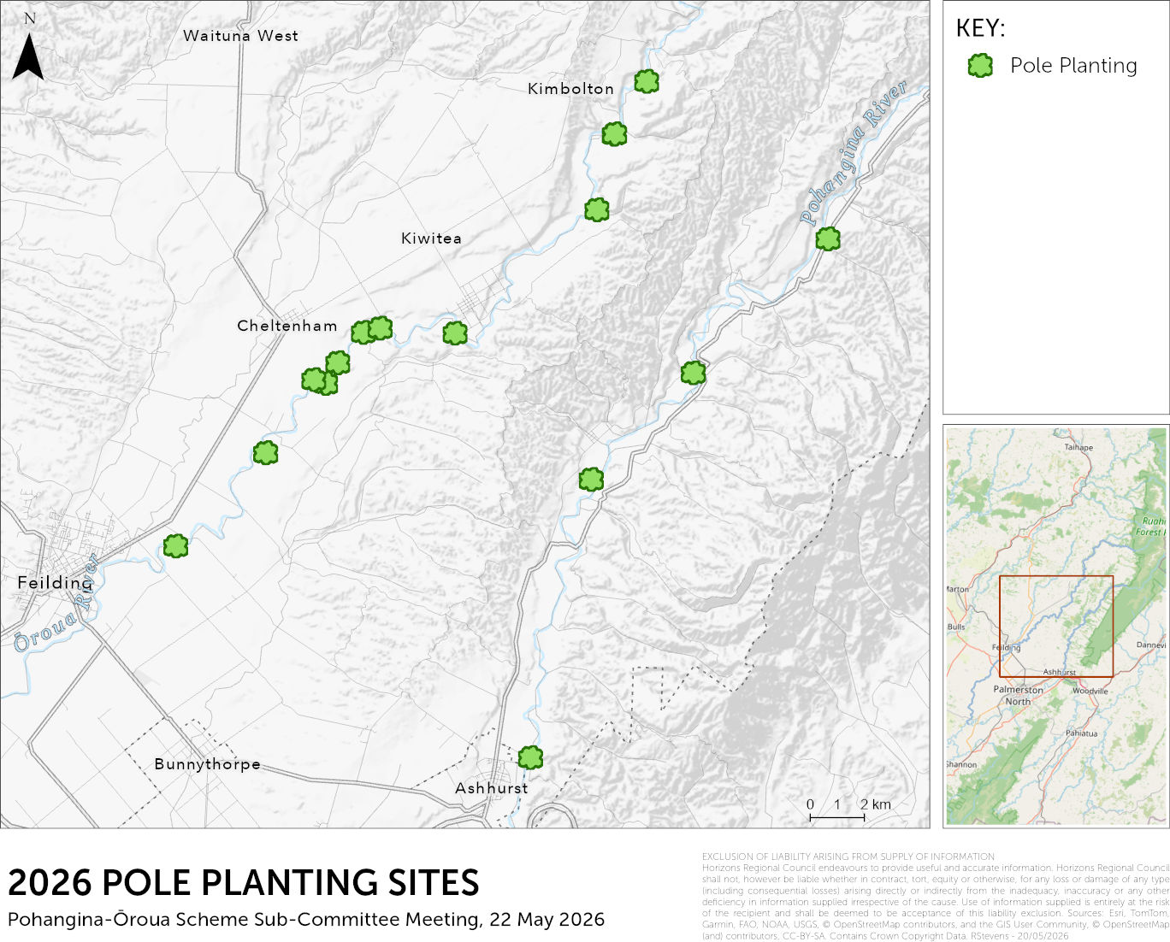
River | Priority | Qty to be Planted | Estimated Job Cost ($)
Pohangina | 1 | 1500 | 18,525.00
Ōroua | 1 | 1000 | 10,540.00
Ōroua | 1 | 250 | 2,635.00
Ōroua | 1 | 2000 | 21,080.00
Ōroua | 2 | 500 | 8,225.00
Ōroua | 2 | 300 | 4,935.00
Ōroua | 2 | 1000 | 16,450.00
Ōroua | 2 | 1000 | 16,450.00
Ōroua | 2 | 500 | 5,270.00
Ōroua | 2 | 1500 | 15,810.00
Ōroua | 2 | 300 | 3,162.00
Pohangina | 2 | 450 | 4,743.00
Pohangina | 2 | 1000 | 10,540.00
Pohangina | 2 | 600 | 6,324.00
Ōroua | 3 | 500 | 8,225.00
Total proposed cost $152k.
Priority Definitions & Prerequisites
PRIORITY 1 | Recent repair work completed
PRIORITY 2 | Infrastructure or asset at risk
PRIORITY 3 | Areas that require a top up

Slide 11
Repair priorities – all repairs merged list $1.36M (31 jobs)
 | Priority definitions & prerequisites
P1 | Parcel-land or Infrastructure (House or cowshed) at risk
P2 | Fragile asset under threat or a ‘quick win’
P3 | Parcel-land or Scheme asset (River structure) at risk
P4 | Parcel-land with no asset (River structure) at risk / Accretion land / No recent investment / Farming infrastructure (Fence, Farm race, Irrigation equipment) at risk
P5 | Completed or Cancelled
12 | Ōroua | P3 | 60,000 | In Planning
13 | Ōroua | P3 | 5,000 | In Planning
14 | Ōroua | P3 | 45,000 | In Planning
15 | Ōroua | P3 | 80,000 | In Planning
18 | Pohangina | P3 | 25,000 | In Planning
21 | Ōroua | P3 | 20,000 | In Planning
23 | Pohangina | P3 | 45,000 | In Planning
24 | Pohangina | P3 | 50,000 | In Planning
27 | Pohangina | P3 | 65,000 | In Planning
28 | Pohangina | P3? | 100,000 | In Planning
31 | Pohangina | P3 | 40,000 | In Planning
 |  | P3 subtotal | 535,000
20 | Pohangina | P4 | 45,000 | In Planning
26 | Pohangina | P4 | 45,000 | In Planning
30 | Pohangina | P4 | 65,000 | In Planning
 |  | P4 subtotal | 155,000
 | FUTURE WORK TOTAL |  | $1,361,473
Order | River | Priority | Engineer’s Estimate ($) | Progress
1 | Ōroua | P1 | 12,000 | Scheduled
2 | Ōroua | P1 | 75,000 | Scheduled
4 | Pohangina | P1 | 83,473 | In Planning
 |  | P1 subtotal | 170,473
3 | Pohangina | P2 | 55,000 | In Planning
5 | Ōroua | P2 | 15,000 | In Planning
6 | Ōroua | P2 | 6,000 | In Planning
7 | Pohangina | P2 | 49,000 | In Planning
8 | Pohangina | P2 | 6,000 | In Planning
9 | Ōroua | P2 | 60,000 | In Planning
10 | Pohangina | P2 | 22,500 | In Planning
11 | Ōroua | P2 | 15,000 | In Planning
16 | Pohangina | P2 | 60,000 | In Planning
17 | Ōroua | P2 | 100,000 | In Planning
19 | Ōroua | P2 | 40,000 | In Planning
22 | Ōroua | P2 | 35,000 | In Planning
25 | Pohangina | P2 | 22,500 | In Planning
29 | Pohangina | P2 | 15,000 | In Planning
 |  | P2 subtotal | 501,000
0 | Pohangina | P5 | (blank) | Not in Scheme
0 | Tokeawa | P5 | (blank) | Not a Repair
0 | Ōroua | P5 | (blank) | Landowner Not Sure
0 | Ōroua | P5 | (blank) | Landowner Not Sure
0 | Ōroua | P5 | 45,000 | Work Completed
0 | Pohangina | P5 | 150,000
0 | Ōroua | P5 | (blank)
 | Work no longer on future work list |  | $195000

Slide 12
2026-27 Maintenance and Repair Options
Option 1 would leave the repair budget of $271,241
Option 2 would leave a repair budget of $773,526
Both include landowner share. Note more landowner share required for option 2 and more staff time as it is a bigger repair programme
With maintenance option 1 plus $270k of repairs is a total budget of $974k 45% more than the annual plan budget.
With maintenance option 2 plus $770k of repairs is a total budget of $1.275M, 90% more than the annual plan budget.
Both examples above have not accounted for the additional staff time, or the consented costs.
To do all of the priority 1 (P1) jobs (3) a budget of $170k is required
To do all of the P2 jobs (14) a budget of $501k is required
To do all of the P3 jobs (11) a budget of $535k is required
To do all of the P4 jobs (3) a budget of $155k is required
With option 1, could do all of the P1 jobs, and a few P2 jobs
With option 2, could potentially do all of the P1 and P2 jobs
Both options would likely be short on staff capacity to do so

Slide 13
The slides that follow provide more detail on the specific jobs to inform the discussion

Slide 14
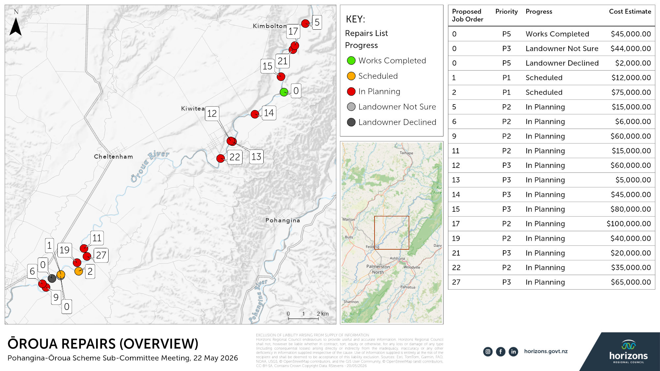

Slide 15
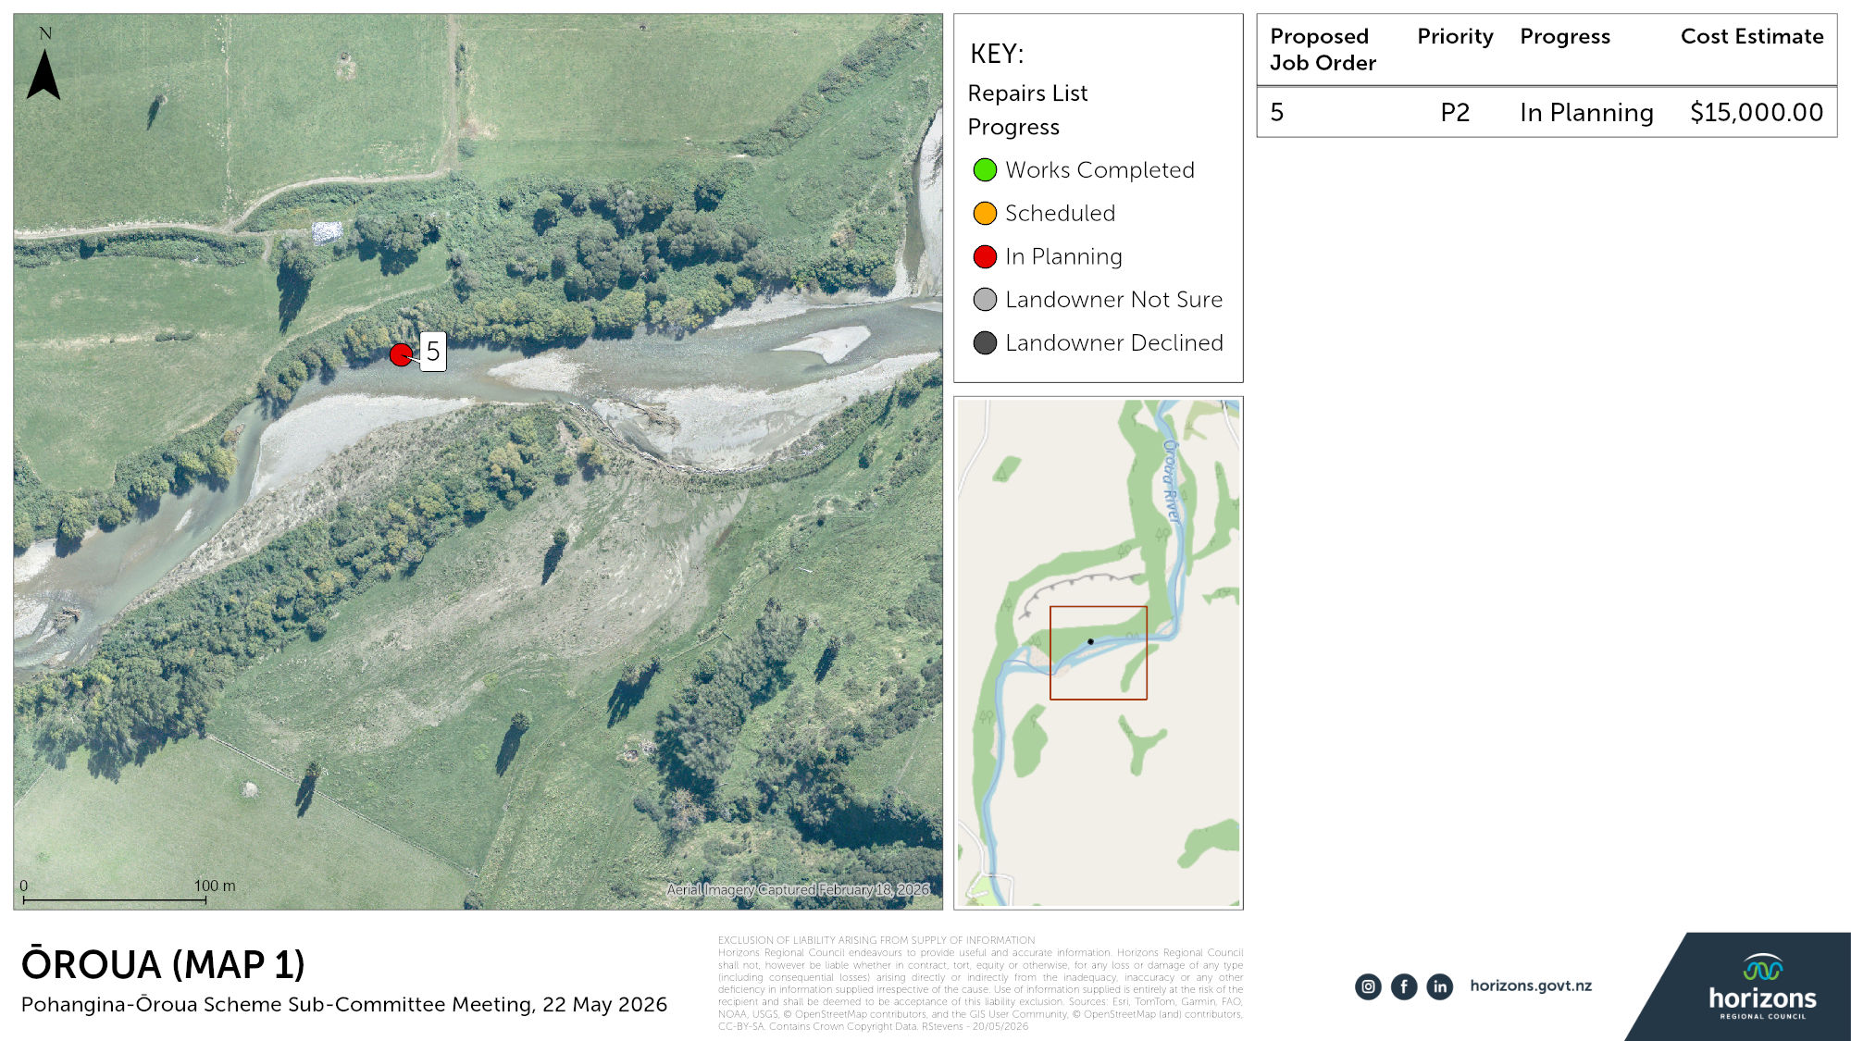

Slide 16
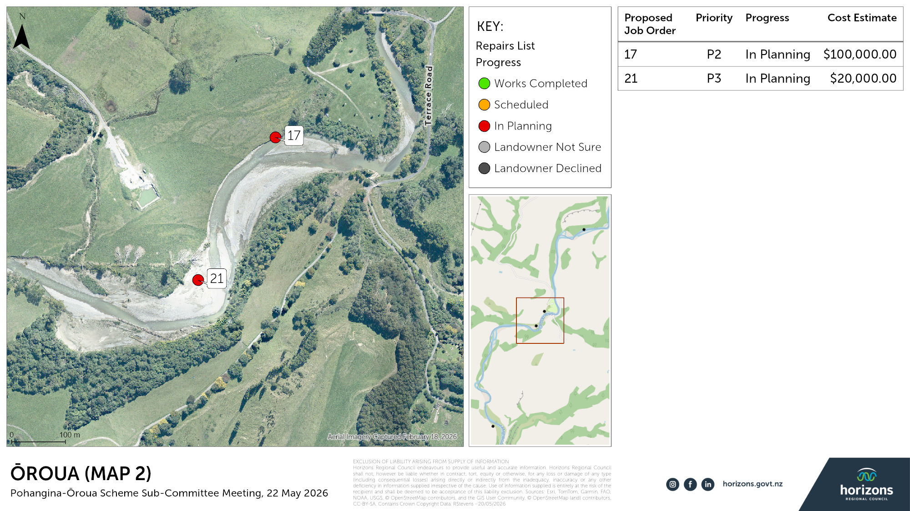

Slide 17
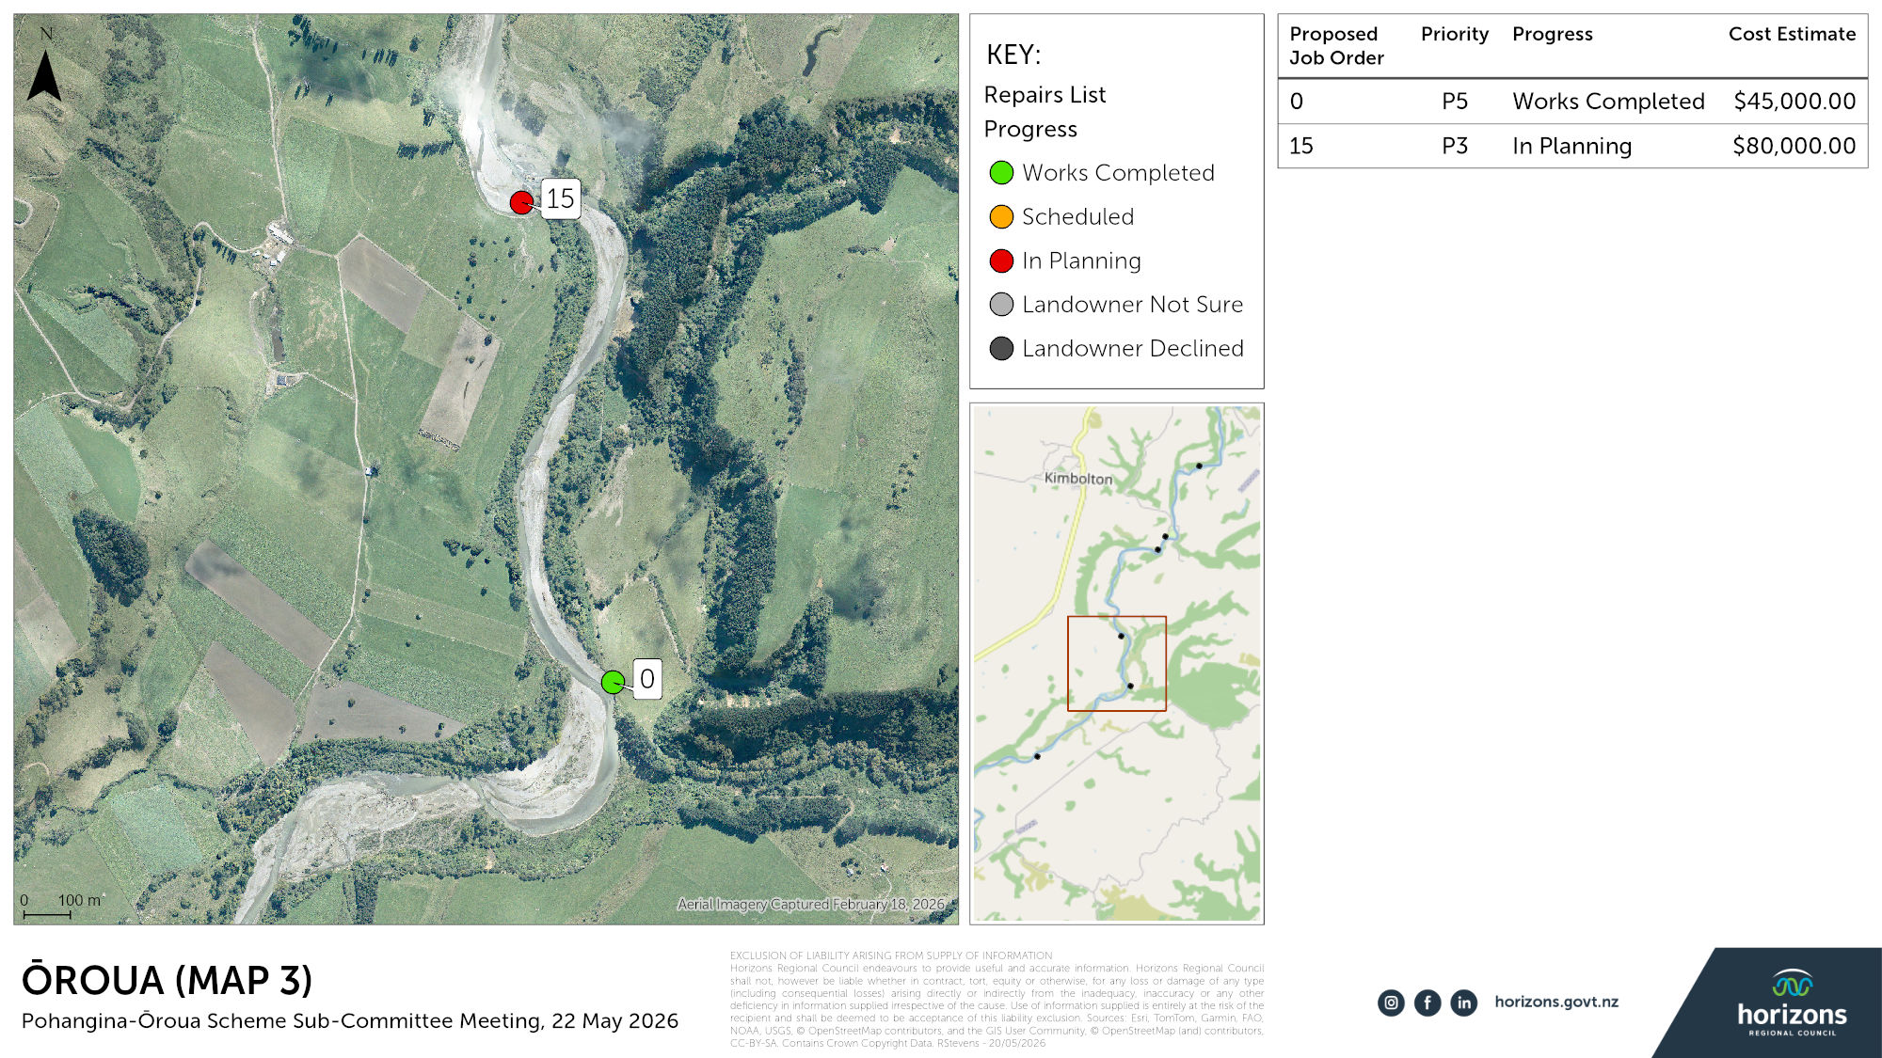

Slide 18
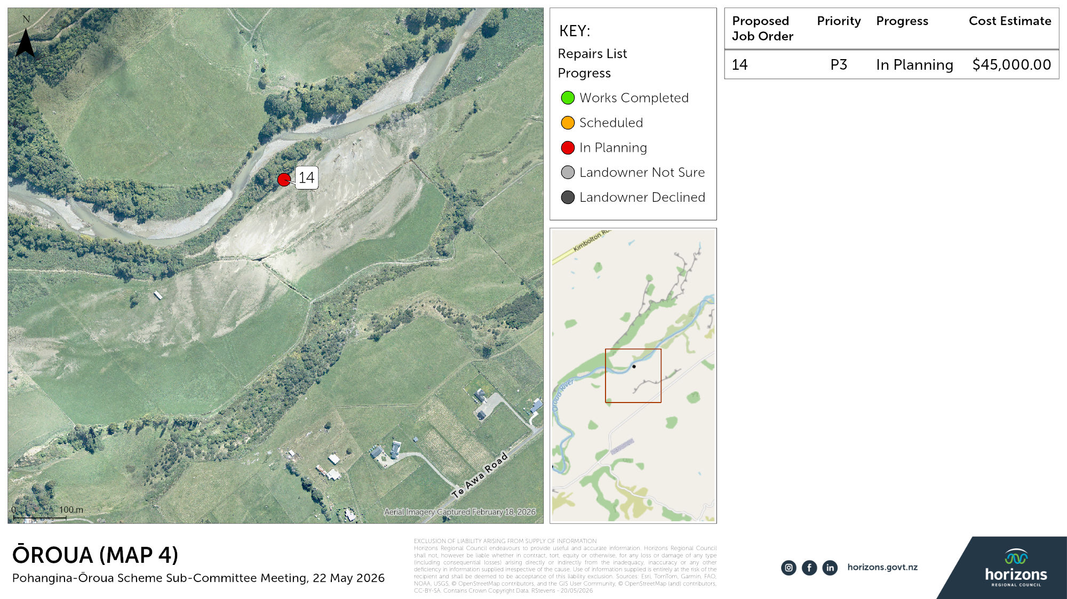

Slide 19
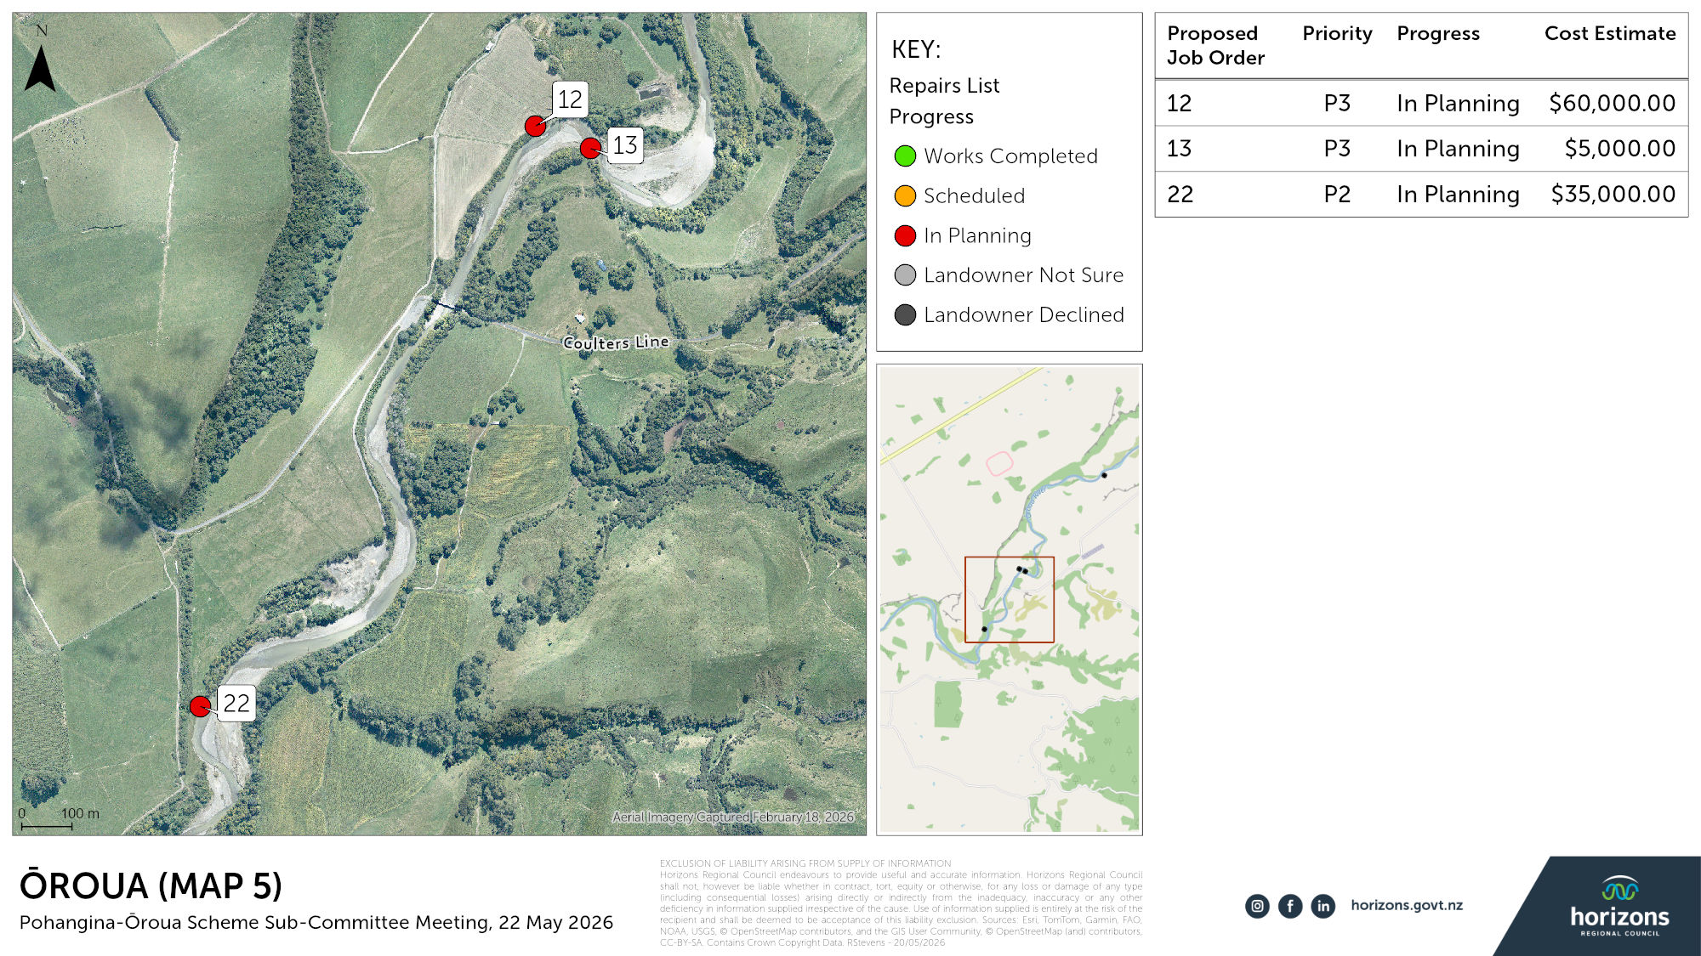

Slide 20
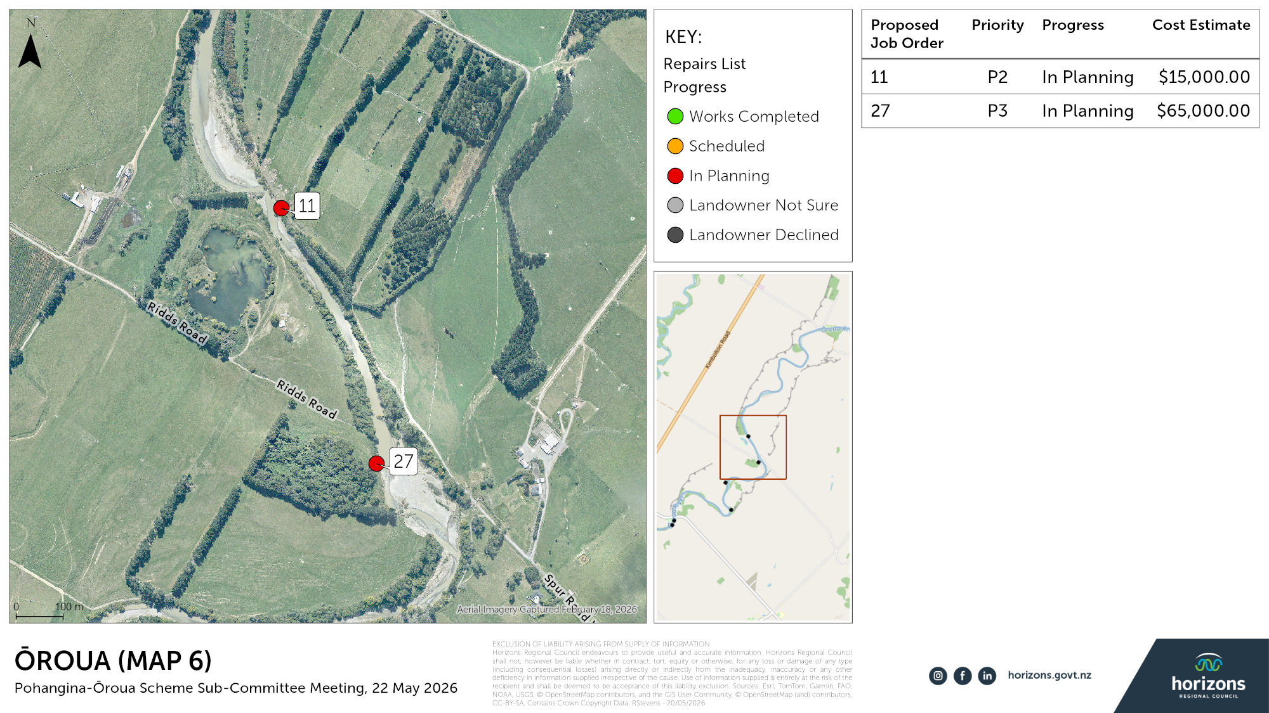

Slide 21
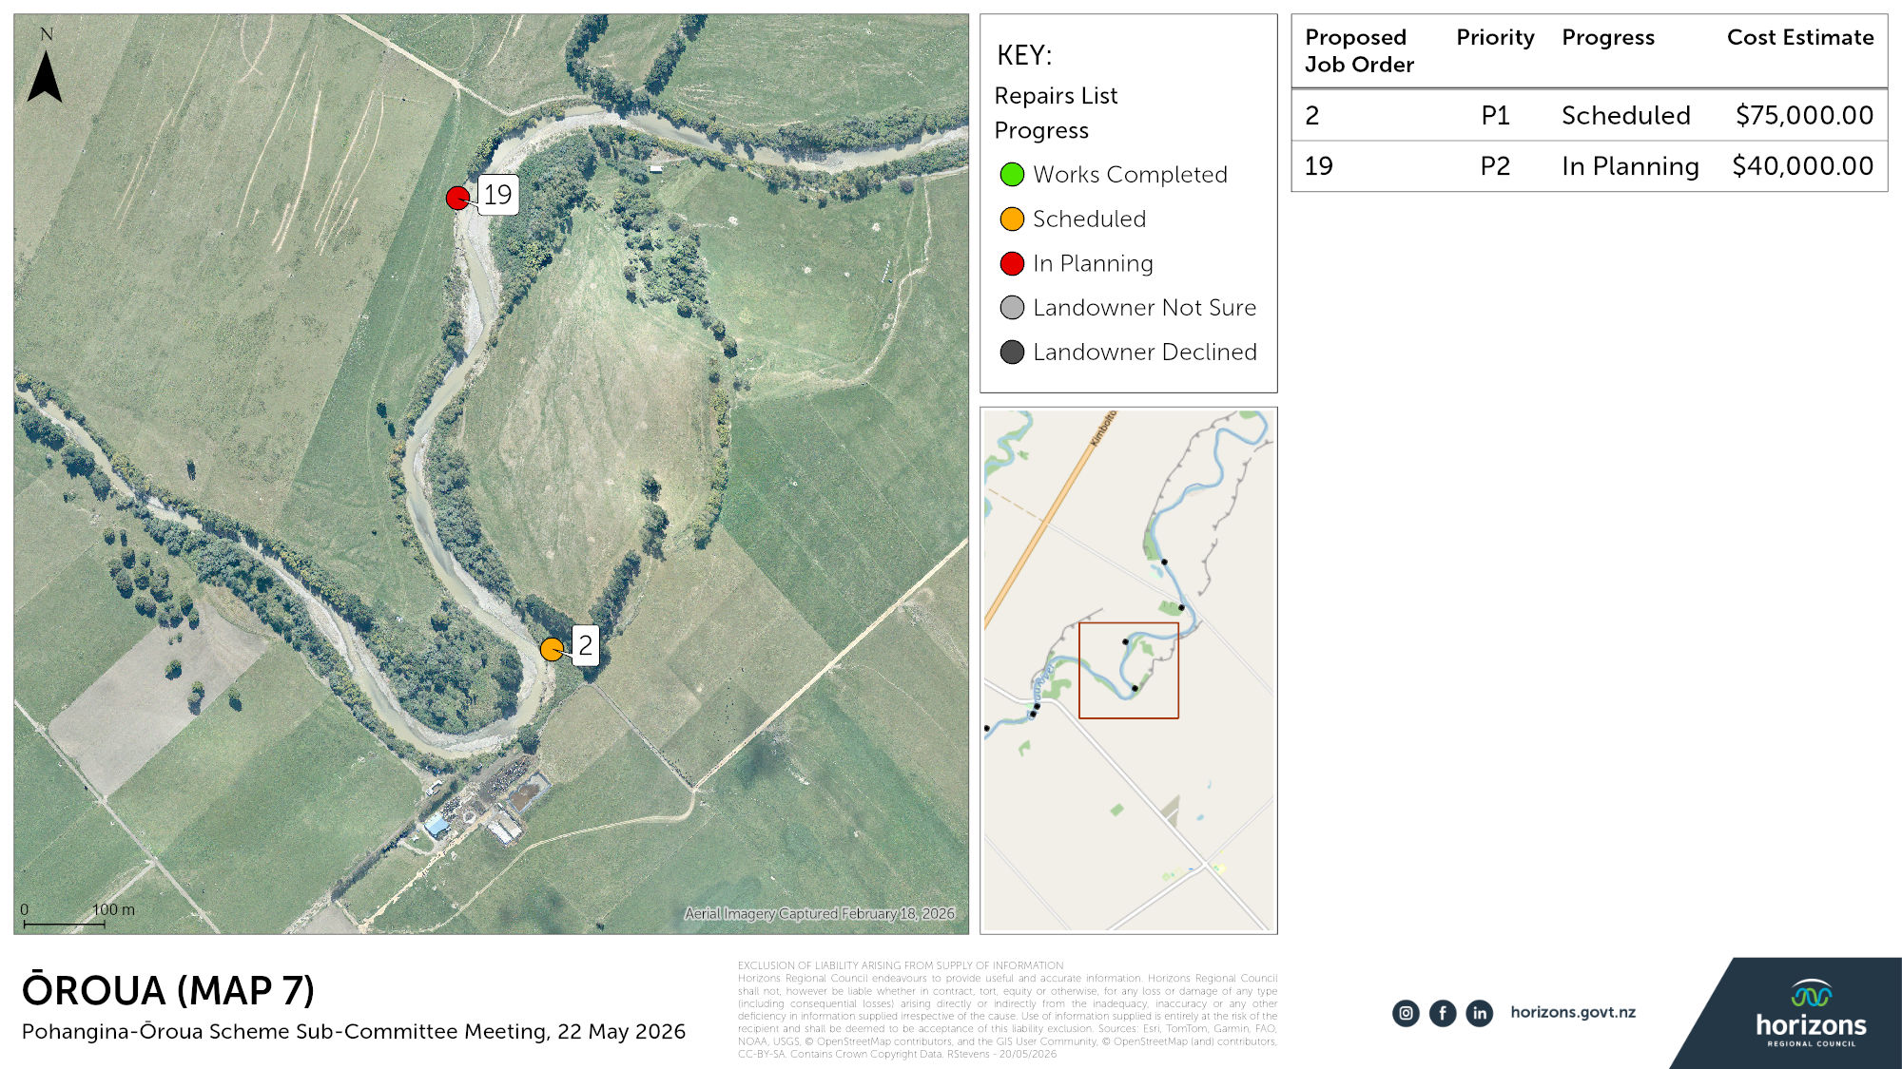

Slide 22
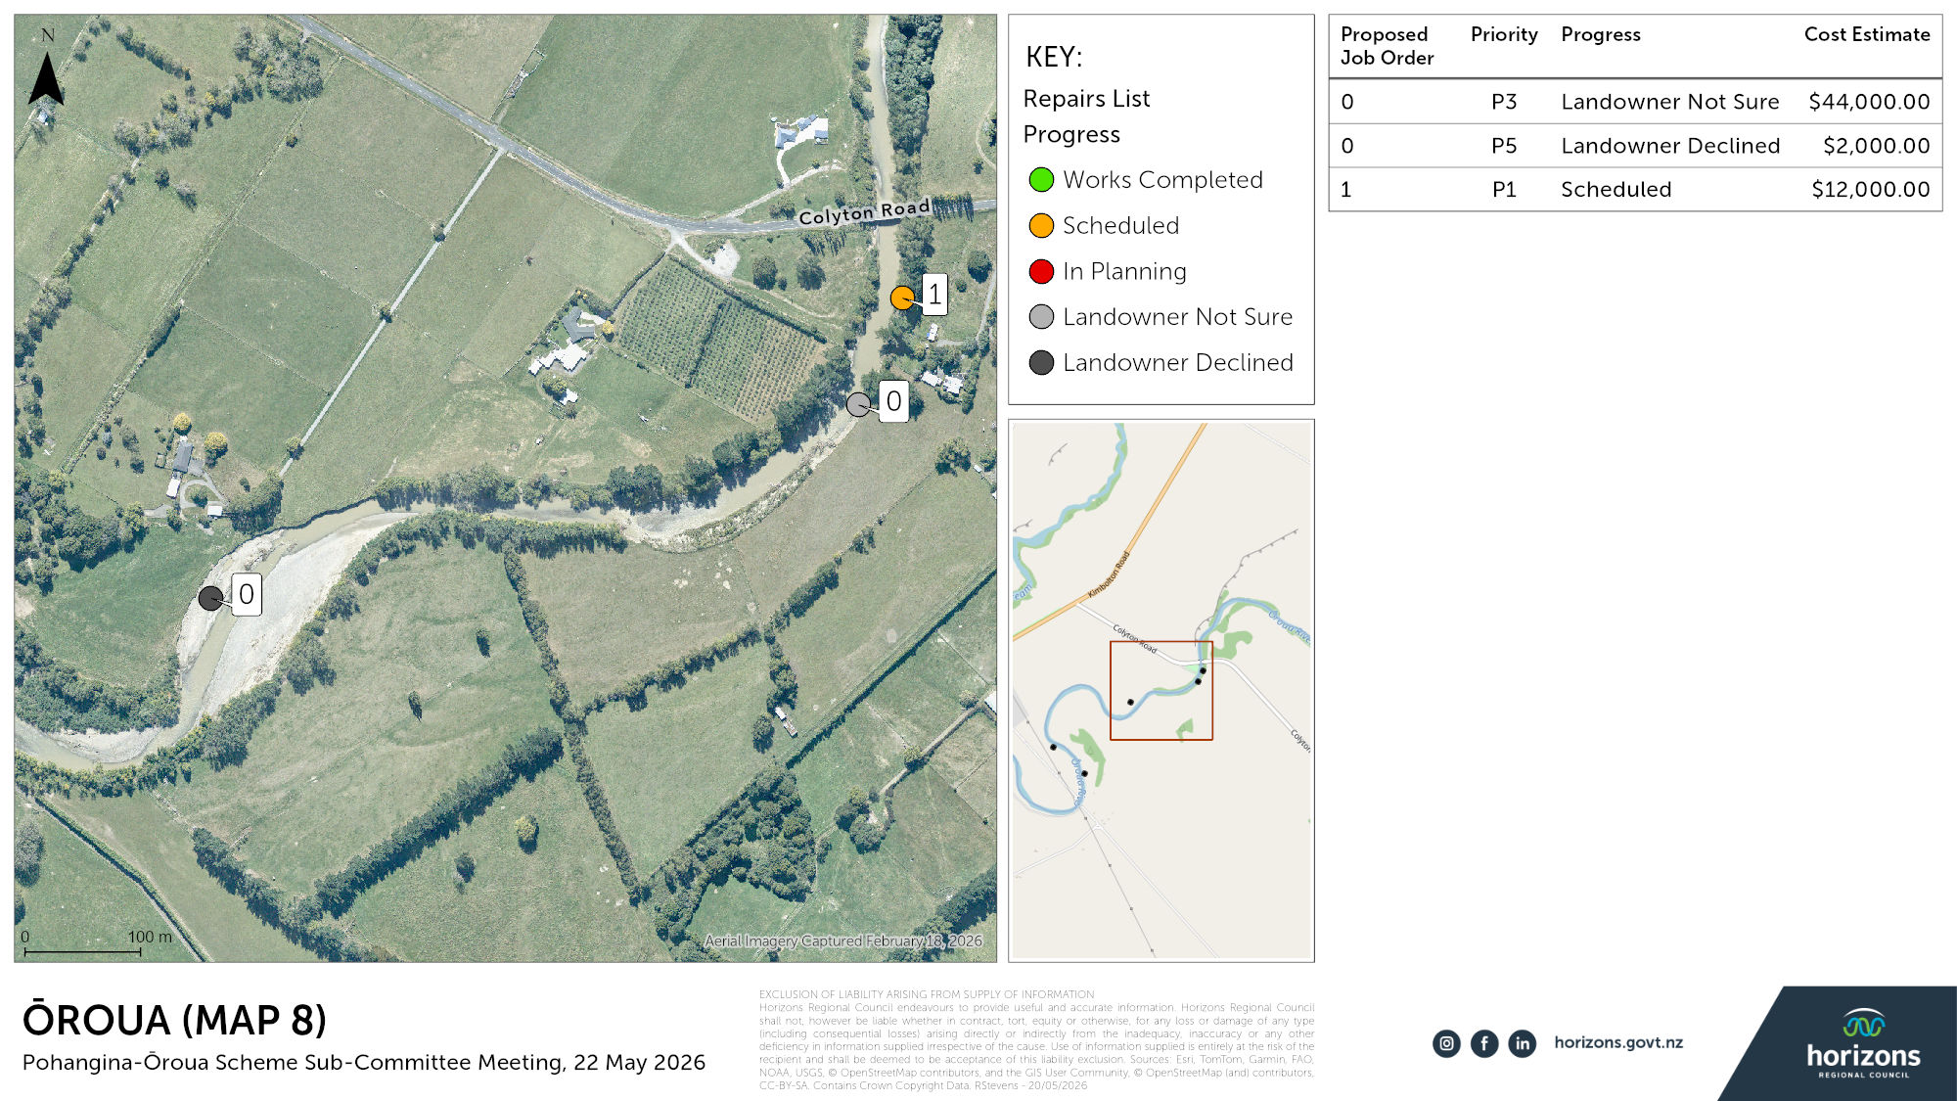

Slide 23
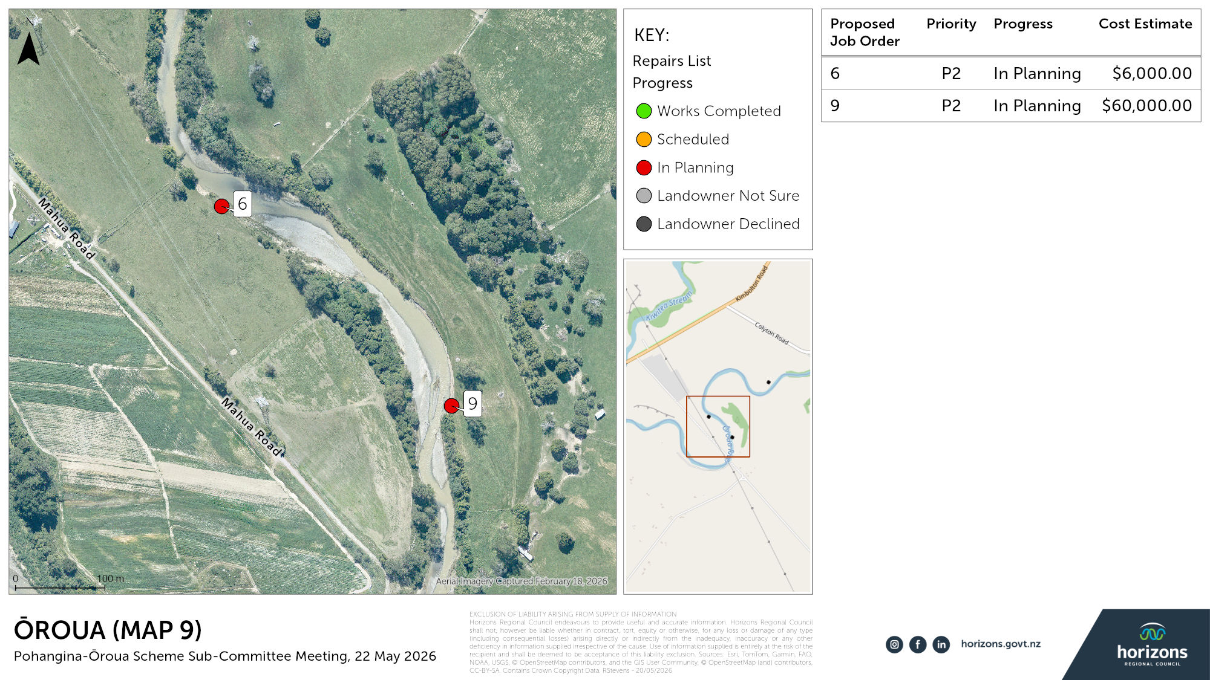

Slide 24
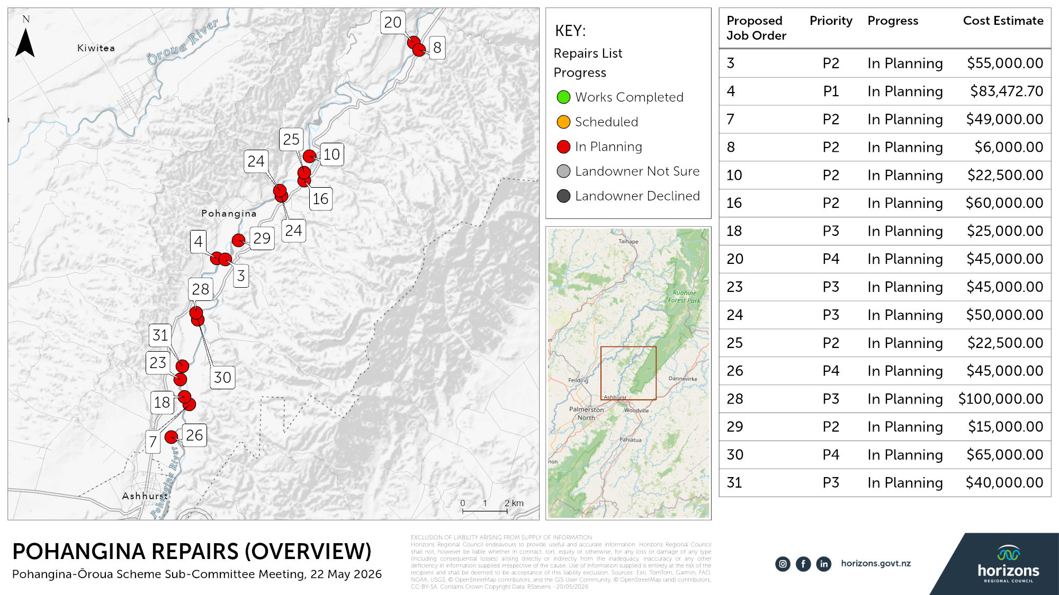

Slide 25
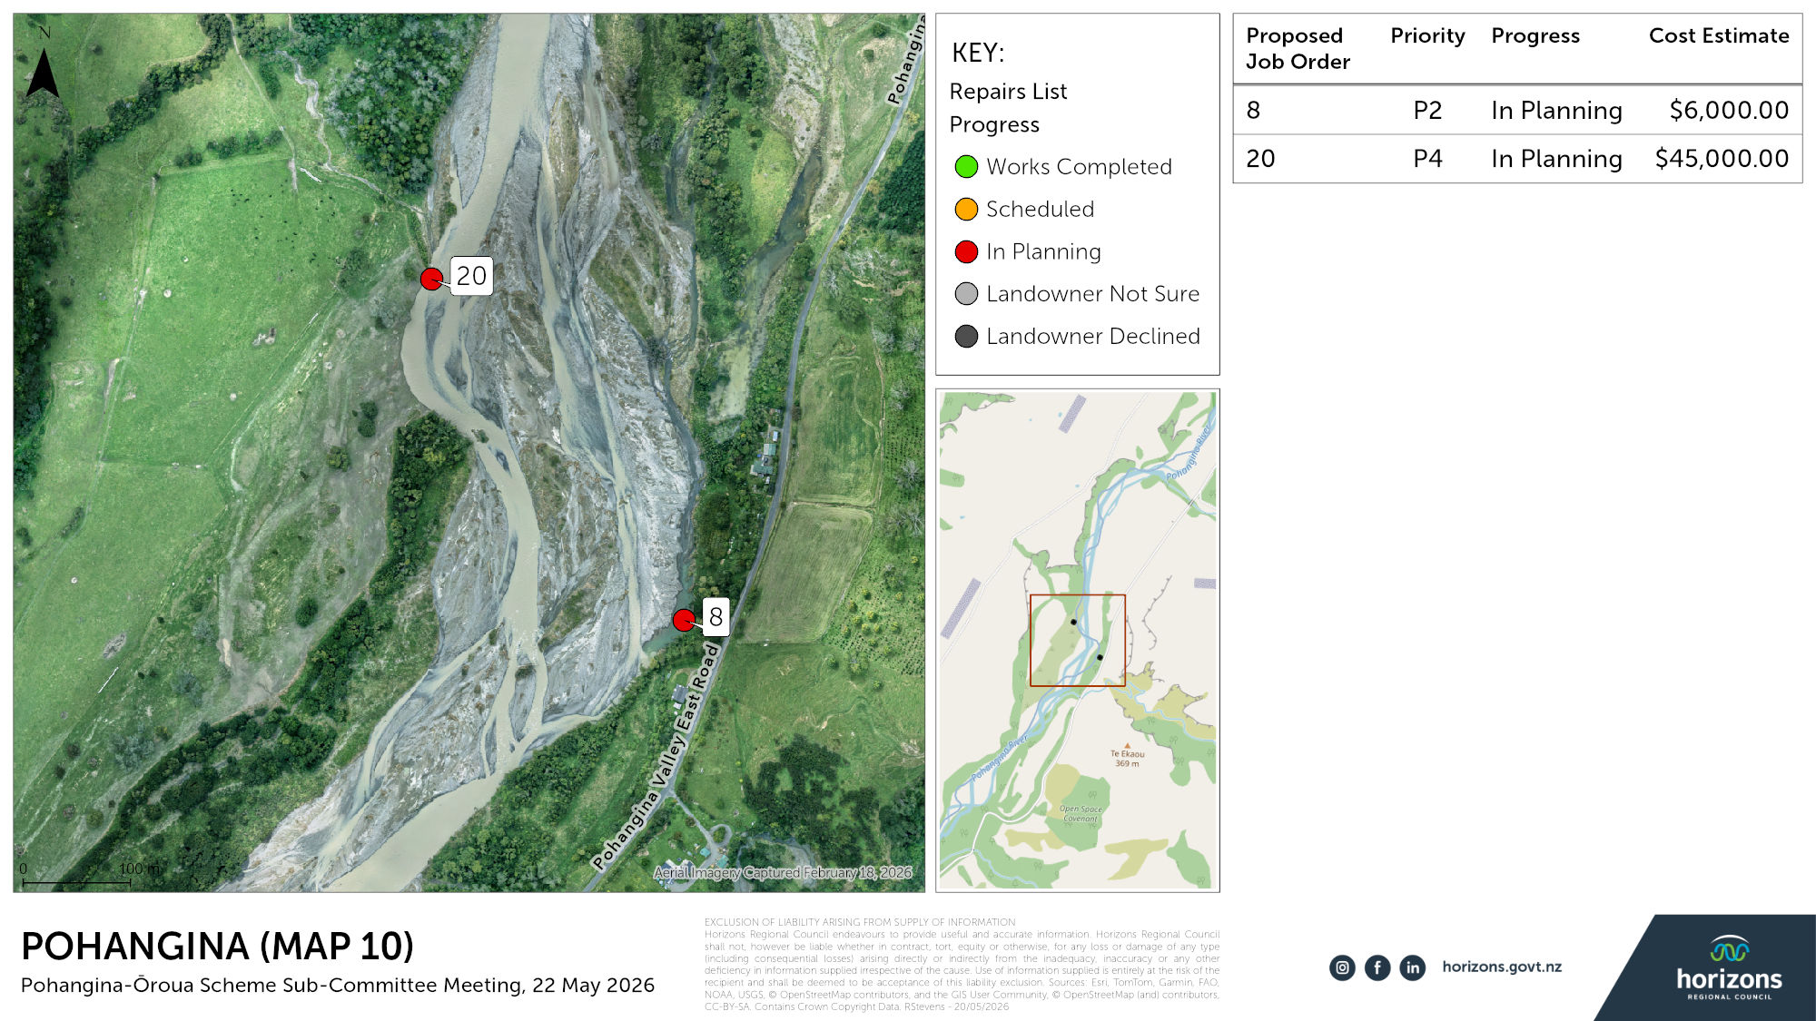

Slide 26
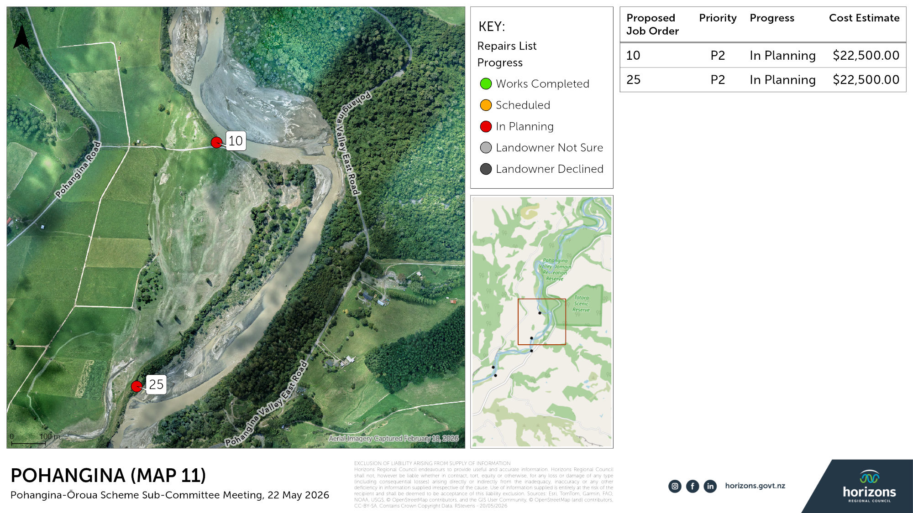

Slide 27
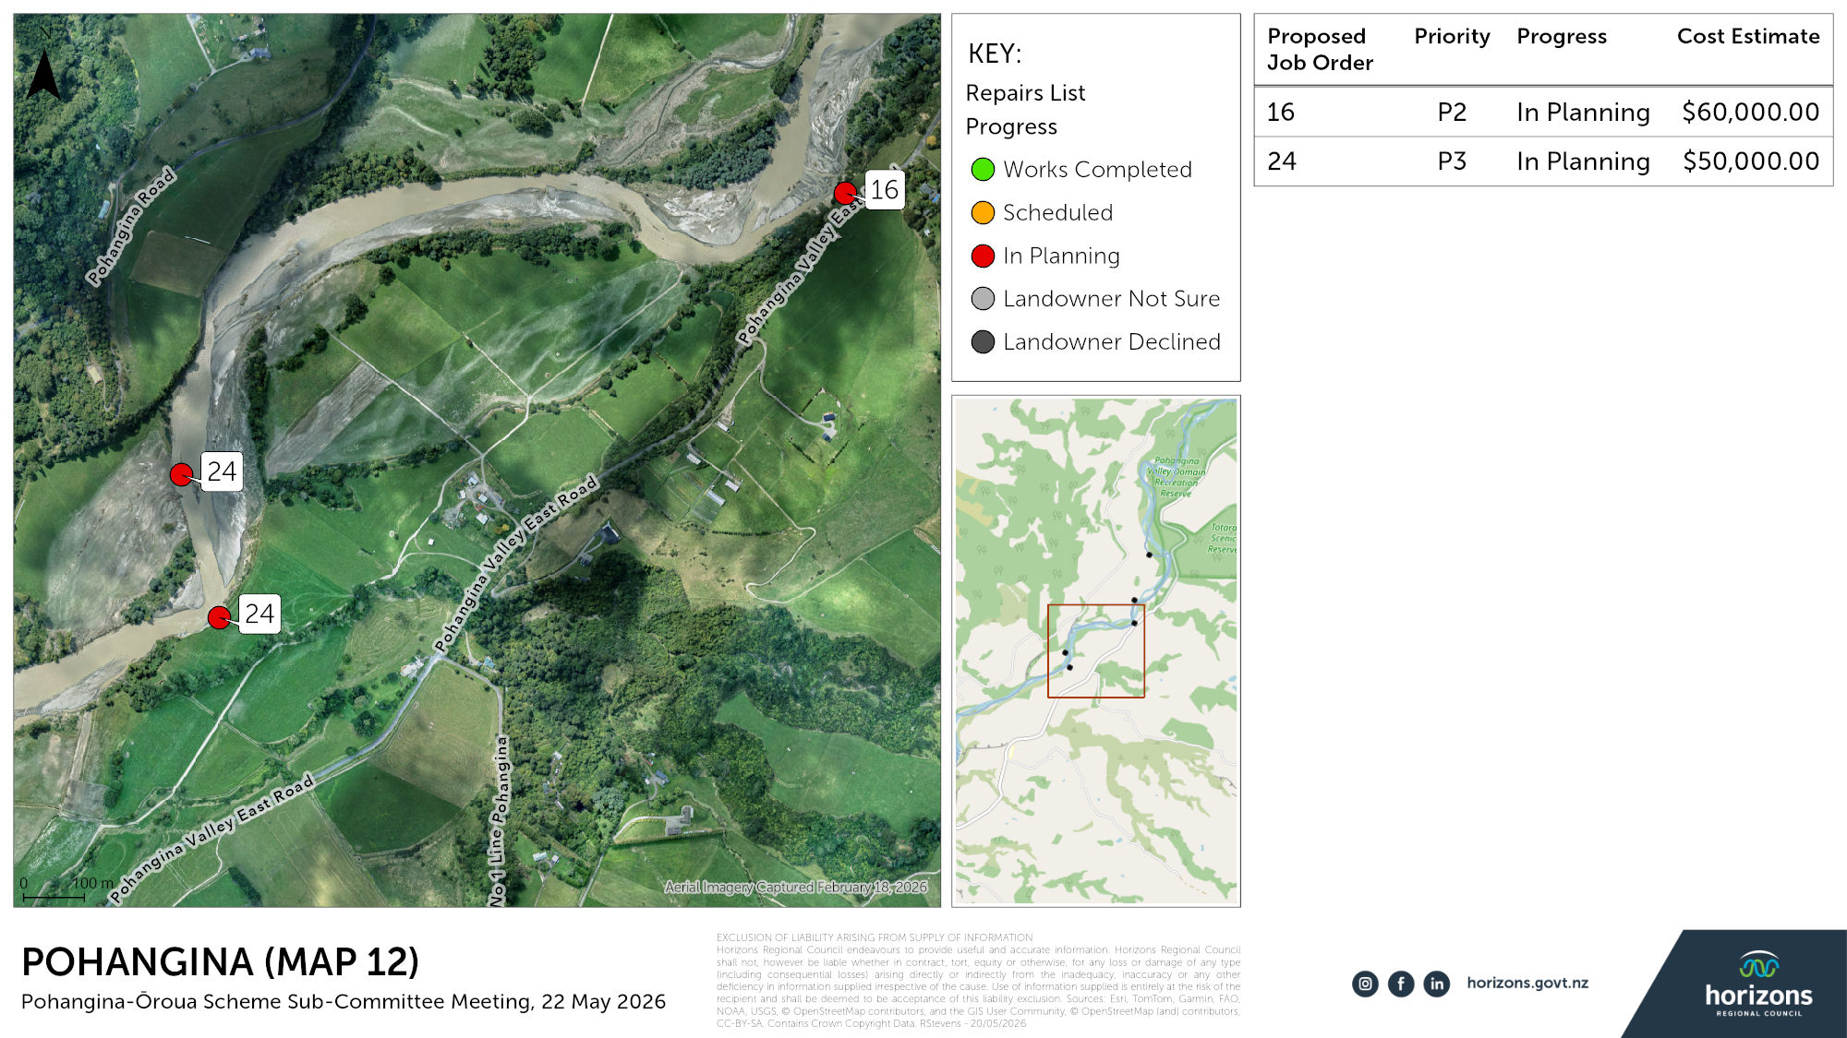

Slide 28
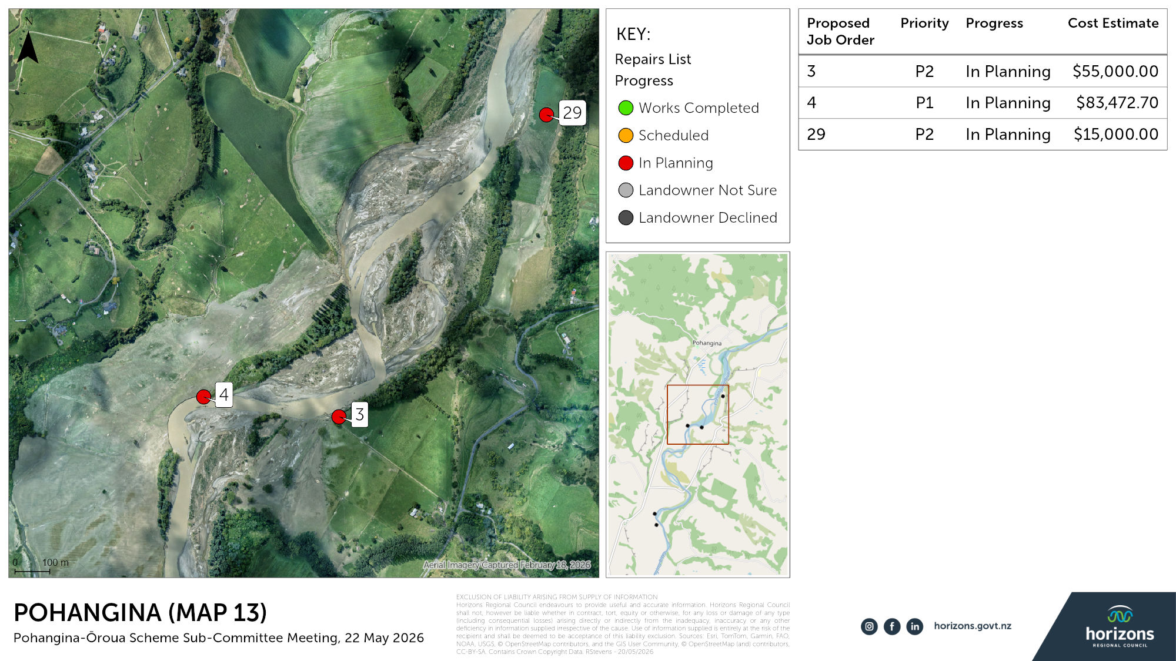

Slide 29
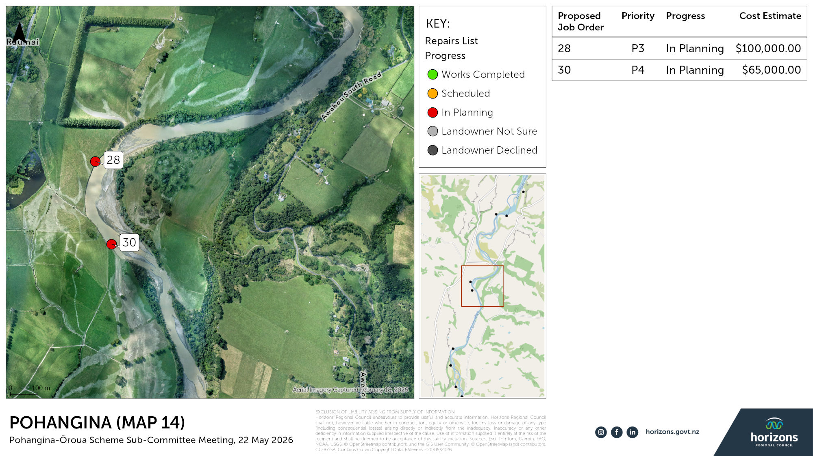

Slide 30
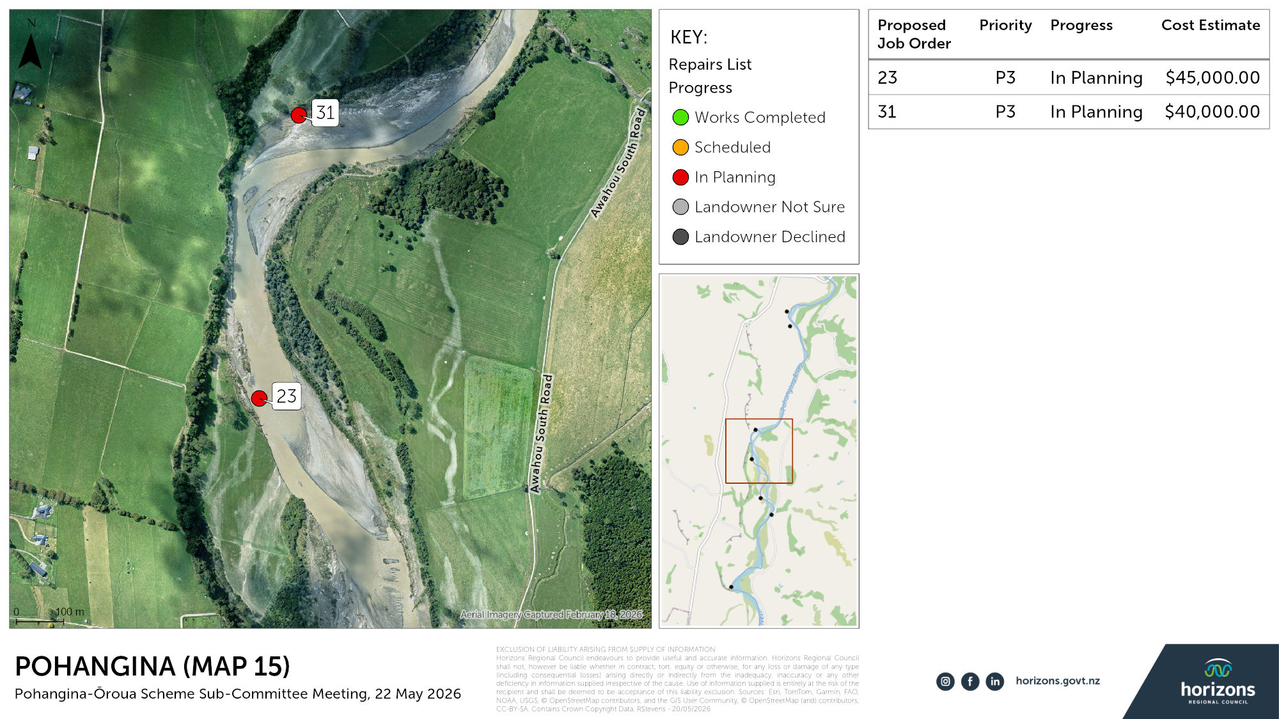

Slide 31
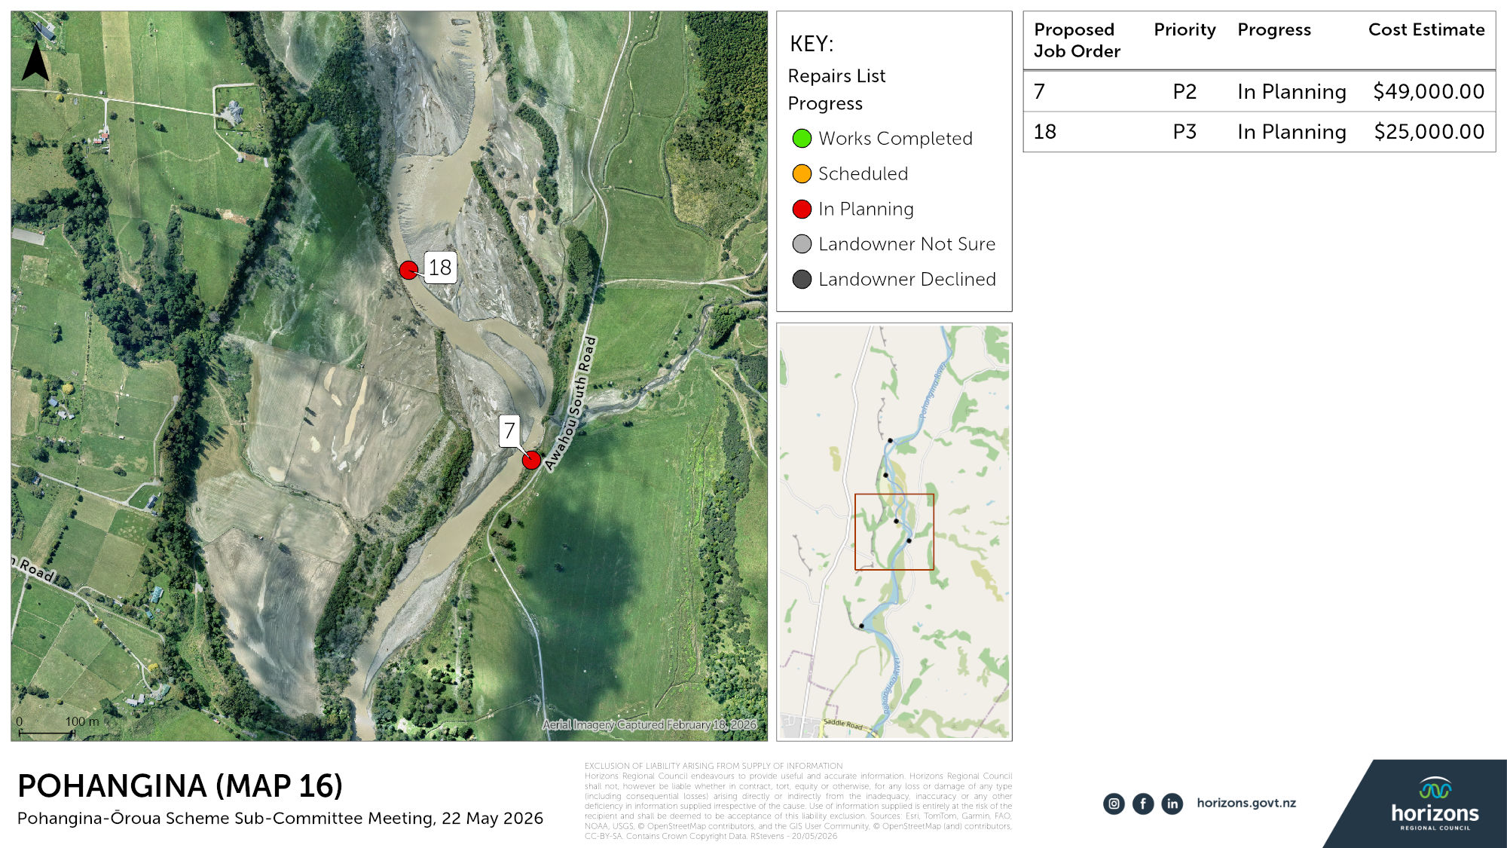

Slide 32
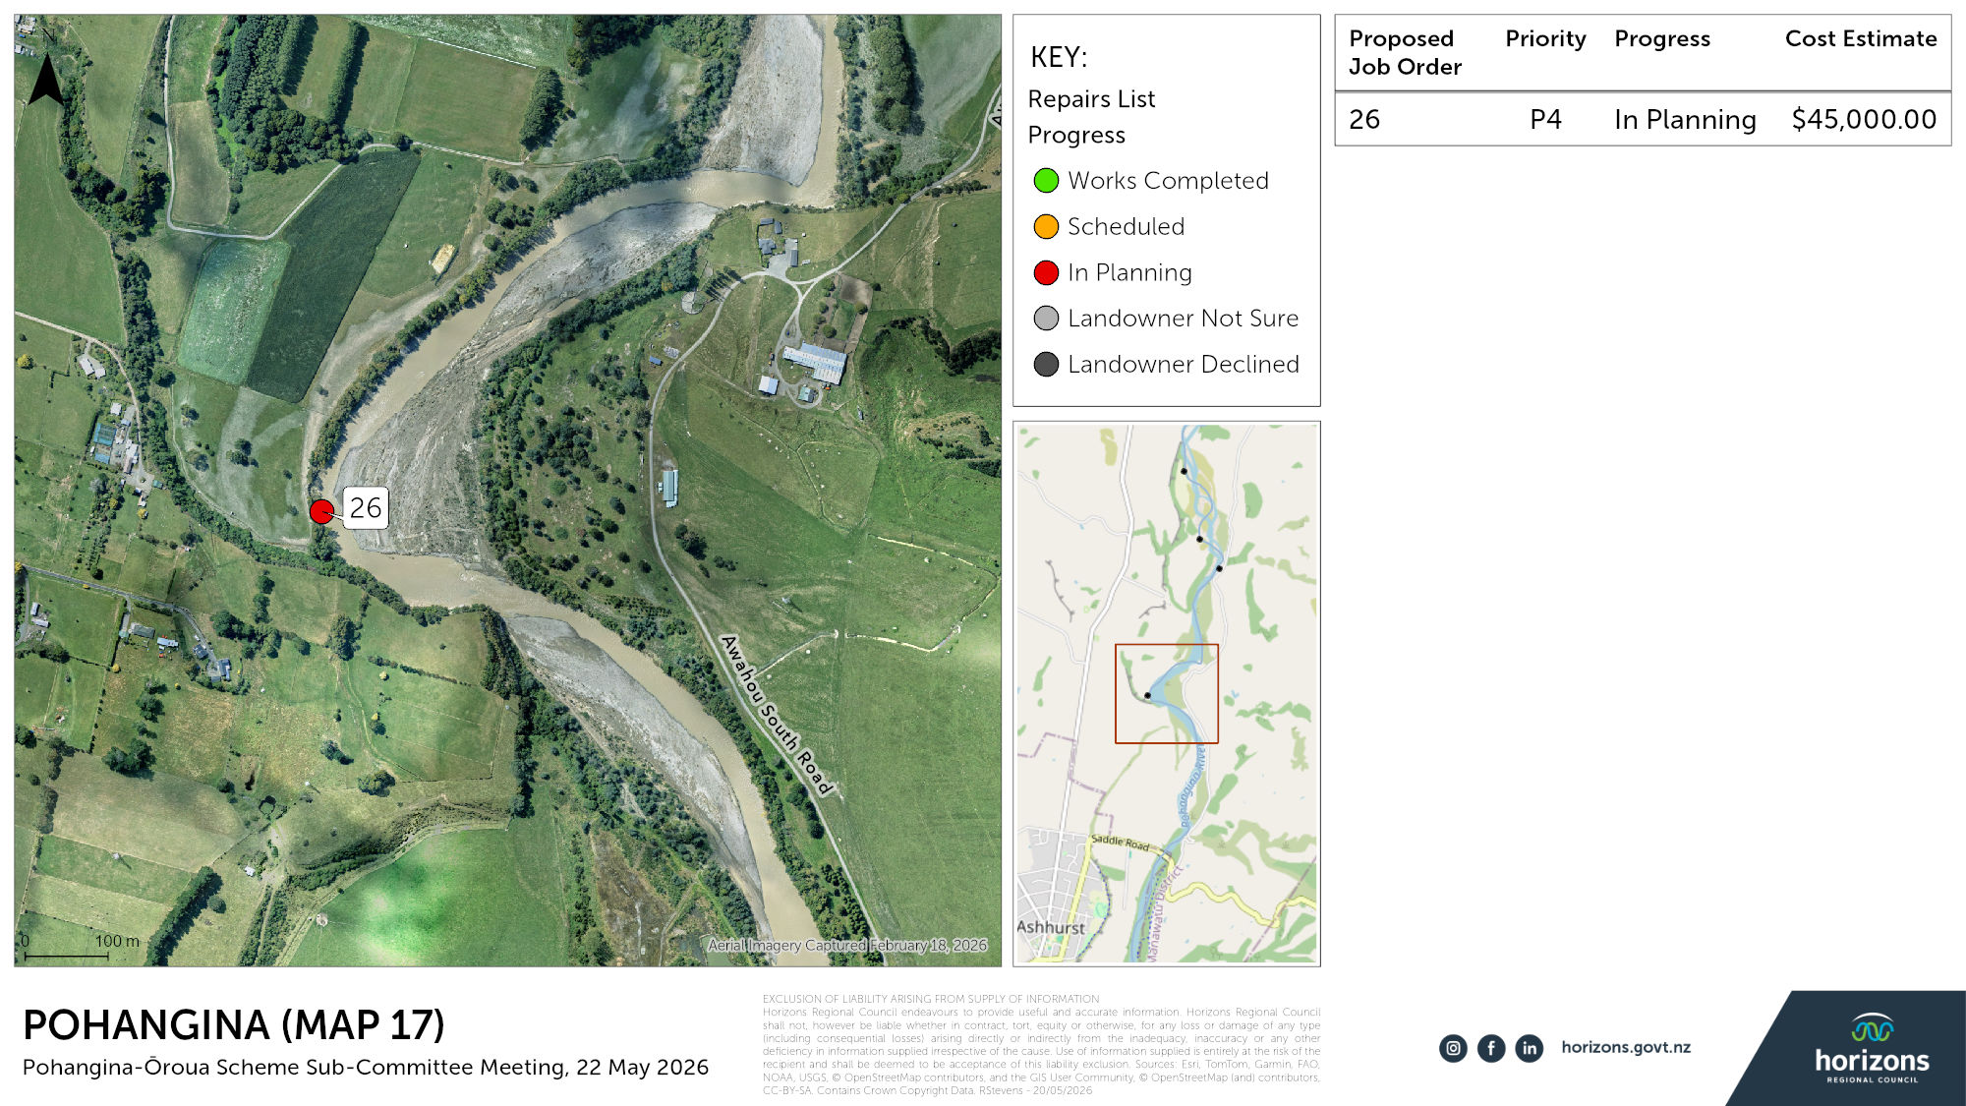

Slide 34
Repair priorities – all repairs merged list $1.45M (33 jobs)
 | Priority definitions & prerequisites
P1 | Parcel-land or Infrastructure (House or cowshed) at risk
P2 | Fragile asset under threat or a ‘quick win’
P3 | Parcel-land or Scheme asset (River structure) at risk
P4 | Parcel-land with no asset (River structure) at risk / Accretion land / No recent investment / Farming infrastructure (Fence, Farm race, Irrigation equipment) at risk
P5 | Completed or Cancelled
12 | Ōroua | P3 | 60,000 | In Planning
13 | Ōroua | P3 | 5,000 | In Planning
14 | Ōroua | P3 | 45,000 | In Planning
15 | Ōroua | P3 | 80,000 | In Planning
18 | Pohangina | P3 | 25,000 | In Planning
21 | Ōroua | P3 | 20,000 | In Planning
23 | Pohangina | P3 | 150,000 | In Planning
24 | Pohangina | P3 | 45,000 | In Planning
25 | Pohangina | P3 | 50,000 | In Planning
29 | Ōroua | P3 | 65,000 | In Planning
30 | Pohangina | P3? | 100,000 | In Planning
33 | Pohangina | P3 | 40,000 | In Planning
 |  | P3 subtotal | 685,000
20 | Pohangina | P4 | 45,000 | In Planning
27 | Pohangina | P4 | 45,000 | In Planning
28 | Ōroua | P5 | 2,000 | In Planning
32 | Pohangina | P4 | 65,000 | In Planning
 |  | P4 subtotal | 157,000
 | FUTURE WORK TOTAL |  | $1,458,473
Order | River | Priority | Engineer’s Estimate ($) | Progress
1 | Ōroua | P1 | 12,000 | Scheduled
2 | Ōroua | P1 | 75,000 | Scheduled
4 | Pohangina | P1 | 83,473 | In Planning
 |  | P1 subtotal | 170,473
3 | Pohangina | P2 | 55,000 | In Planning
5 | Ōroua | P2 | 15,000 | In Planning
6 | Ōroua | P2 | 6,000 | In Planning
7 | Pohangina | P2 | 49,000 | In Planning
8 | Pohangina | P2 | 6,000 | In Planning
9 | Ōroua | P2 | 60,000 | In Planning
10 | Pohangina | P2 | 22,500 | In Planning
11 | Ōroua | P2 | 15,000 | In Planning
16 | Pohangina | P2 | 60,000 | In Planning
17 | Ōroua | P2 | 100,000 | In Planning
19 | Ōroua | P2 | 40,000 | In Planning
22 | Ōroua | P2 | 35,000 | In Planning
26 | Pohangina | P2 | 22,500 | In Planning
31 | Pohangina | P2 | 15,000 | In Planning
 |  | P2 subtotal | 446,000
0 | Pohangina | P5 | (blank) | Not in Scheme
0 | Tokeawa | P5 | (blank) | Not a Repair
0 | Ōroua | P5 | 10,000.00 | Landowner Not Sure
0 | Ōroua | P5 | 44,000.00 | Landowner Not Sure
0 | Ōroua | P5 | 45,000.00 | Work Completed
 | Work no longer on future work list |  | $99,000

Slide 35
2026-27 Maintenance and Repair Options
Option 1 would leave the repair budget of $271,241
Option 2 would leave a repair budget of $773,526
Both include landowner share. Note more landowner share required for option 2 and more staff time as it is a bigger repair programme
With maintenance option 1 plus $270k of repairs is a total budget of $974k 45% more than the annual plan budget.
With maintenance option 2 plus $770k of repairs is a total budget of $1.275M, 90% more than the annual plan budget.
Both examples above have not accounted for the additional staff time, or the consented costs.
To do all of the priority 1 (P1) jobs (3) a budget of $170k is required
To do all of the P2 jobs (14) a budget of $446k is required
To do all of the P3 jobs (12) a budget of $685k is required
To do all of the P4 jobs (4) a budget of $157k is required
With option 1, could do all of the P1 jobs, and a few P2 jobs
With option 2, could potentially do all of the P1 and P2 jobs
Both options would likely be short on staff capacity to do so

