Slide 1
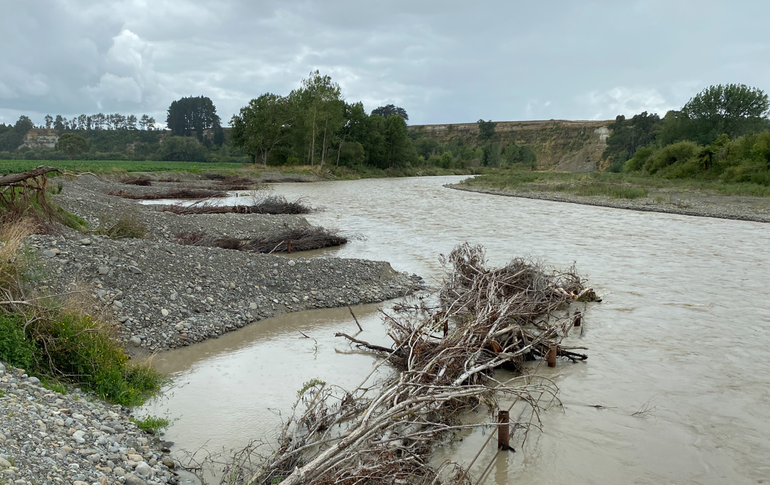
Pohangina Oroua Scheme
12th June 2026
Venue: Te Ao Nui – Ruru Room
Photo

Slide 2
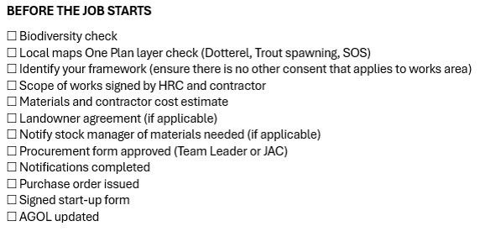
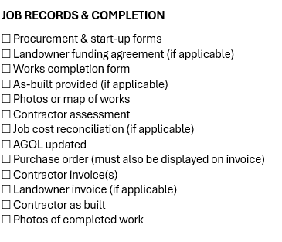
Workflow process FOR ALL JOBS

Slide 3
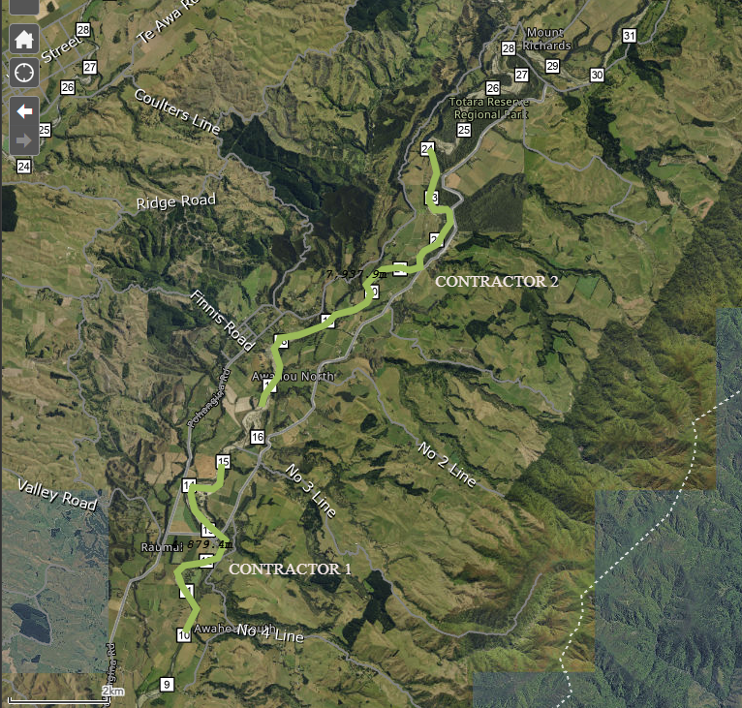
Work plan for remainder 25/26
Currently underway
Oroua channel maintenance 1-13km
Oroua channel maintenance 25-29km
Planned works starting this FY
Pohangina channel maintenance 10-24km
Repair sites x4
Pole planting

Slide 4
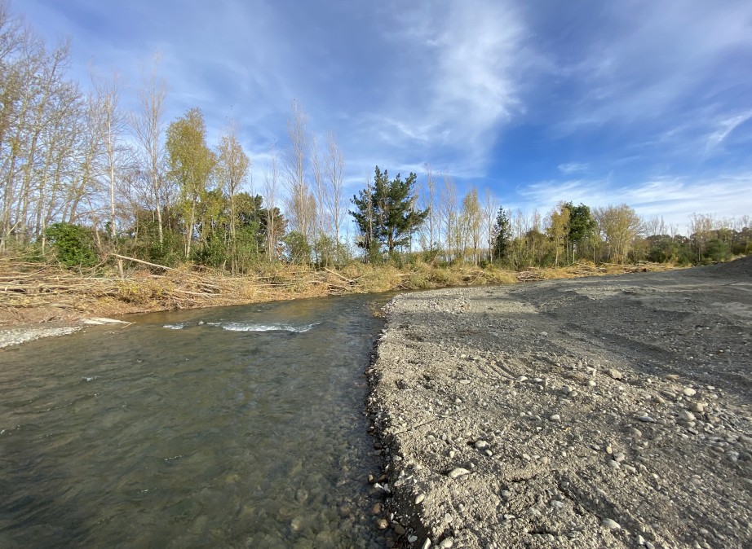
PRIORITY MAINTENANCE WORKS FOR 26/27
Completion of 25/26 works
Oroua channel maintenance 1-13km
Pohangina channel maintenance 10-24km
Repair sites x4
Pole planting continued
New works
Drain maintenance
Tokeawa Edge maintenance
Oroua Almadale to Coulters Line channel maintenance
Oroua channel maintenance 38-39km
Oroua channel maintenance 34km

Slide 5
Repair priorities – all repairs merged list $1.45M (33 jobs)
 | Priority definitions & prerequisites
P1 | Parcel-land or Infrastructure (House or cowshed) at risk
P2 | Fragile asset under threat or a ‘quick win’
P3 | Parcel-land or Scheme asset (River structure) at risk
P4 | Parcel-land with no asset (River structure) at risk / Accretion land / No recent investment / Farming infrastructure (Fence, Farm race, Irrigation equipment) at risk
P5 | Completed or Cancelled
12 | Ōroua | P3 | 60,000 | In Planning
13 | Ōroua | P3 | 5,000 | In Planning
14 | Ōroua | P3 | 45,000 | In Planning
15 | Ōroua | P3 | 80,000 | In Planning
18 | Pohangina | P3 | 25,000 | In Planning
21 | Ōroua | P3 | 20,000 | In Planning
23 | Pohangina | P3 | 150,000 | In Planning
24 | Pohangina | P3 | 45,000 | In Planning
25 | Pohangina | P3 | 50,000 | In Planning
29 | Ōroua | P3 | 65,000 | In Planning
30 | Pohangina | P3? | 100,000 | In Planning
33 | Pohangina | P3 | 40,000 | In Planning
 |  | P3 subtotal | 685,000
20 | Pohangina | P4 | 45,000 | In Planning
27 | Pohangina | P4 | 45,000 | In Planning
28 | Ōroua | P5 | 2,000 | In Planning
32 | Pohangina | P4 | 65,000 | In Planning
 |  | P4 subtotal | 157,000
 | FUTURE WORK TOTAL |  | $1,458,473
Order | River | Priority | Engineer’s Estimate ($) | Progress
1 | Ōroua | P1 | 30000 | Scheduled
2 | Ōroua | P1 | 75,000 | Scheduled
4 | Pohangina | P1 | 60,000 | Scheduled
 |  | P1 subtotal | 165,000
3 | Pohangina | P2 | 110,000 | In Planning
5 | Ōroua | P2 | 15,000 | In Planning
6 | Ōroua | P2 | 6,000 | In Planning
7 | Pohangina | P2 | 49,000 | In Planning
8 | Pohangina | P2 | 6,000 | In Planning
9 | Ōroua | P2 | 60,000 | In Planning
10 | Pohangina | P2 | 22,500 | In Planning
11 | Ōroua | P2 | 15,000 | In Planning
16 | Pohangina | P2 | 60,000 | In Planning
17 | Ōroua | P2 | 100,000 | In Planning
19 | Ōroua | P2 | 40,000 | In Planning
22 | Ōroua | P2 | 35,000 | In Planning
26 | Pohangina | P2 | 22,500 | In Planning
31 | Pohangina | P2 | 15,000 | In Planning
 |  | P2 subtotal | 556,000
0 | Pohangina | P5 | (blank) | Not in Scheme
0 | Tokeawa | P5 | (blank) | Not a Repair
0 | Ōroua | P5 | 10,000.00 | Landowner Not Sure
0 | Ōroua | P5 | 44,000.00 | Landowner Not Sure
0 | Ōroua | P5 | 45,000.00 | Work Completed
 | Work no longer on future work list |  | $99,000

